Slide 1
If you haven’t downloaded the fonts yet, go back to the file that says “START HERE.” It will look way better once you do!

Slide 2
VOLUME TWO
ALSO AVAILABLE
IN MY TPT STORE

Slide 3
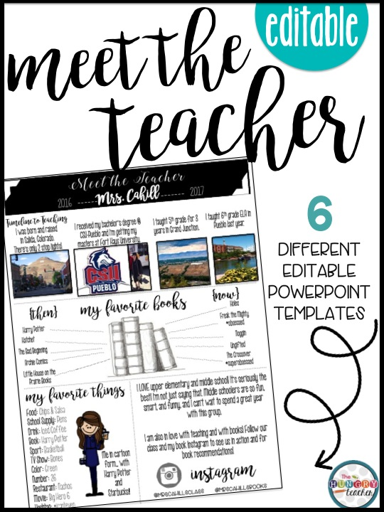
You may also like:

Slide 4
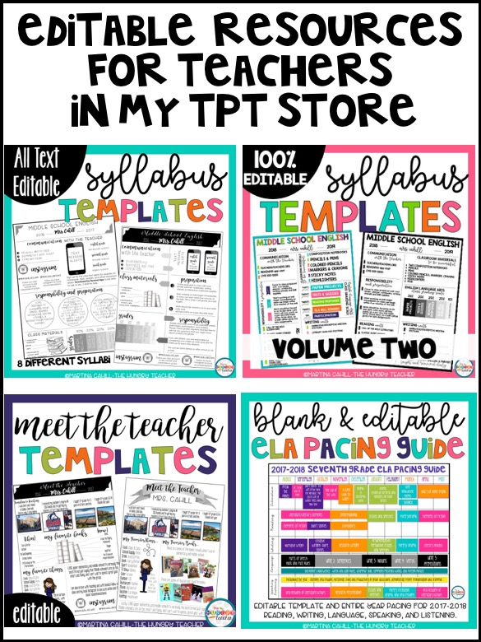

Slide 5
front page templates
The first 16 templates are for the front page of your syllabus.
The last 4 pages can be used for the second page of your syllabus.
(These were added as part of an update!)

Slide 6
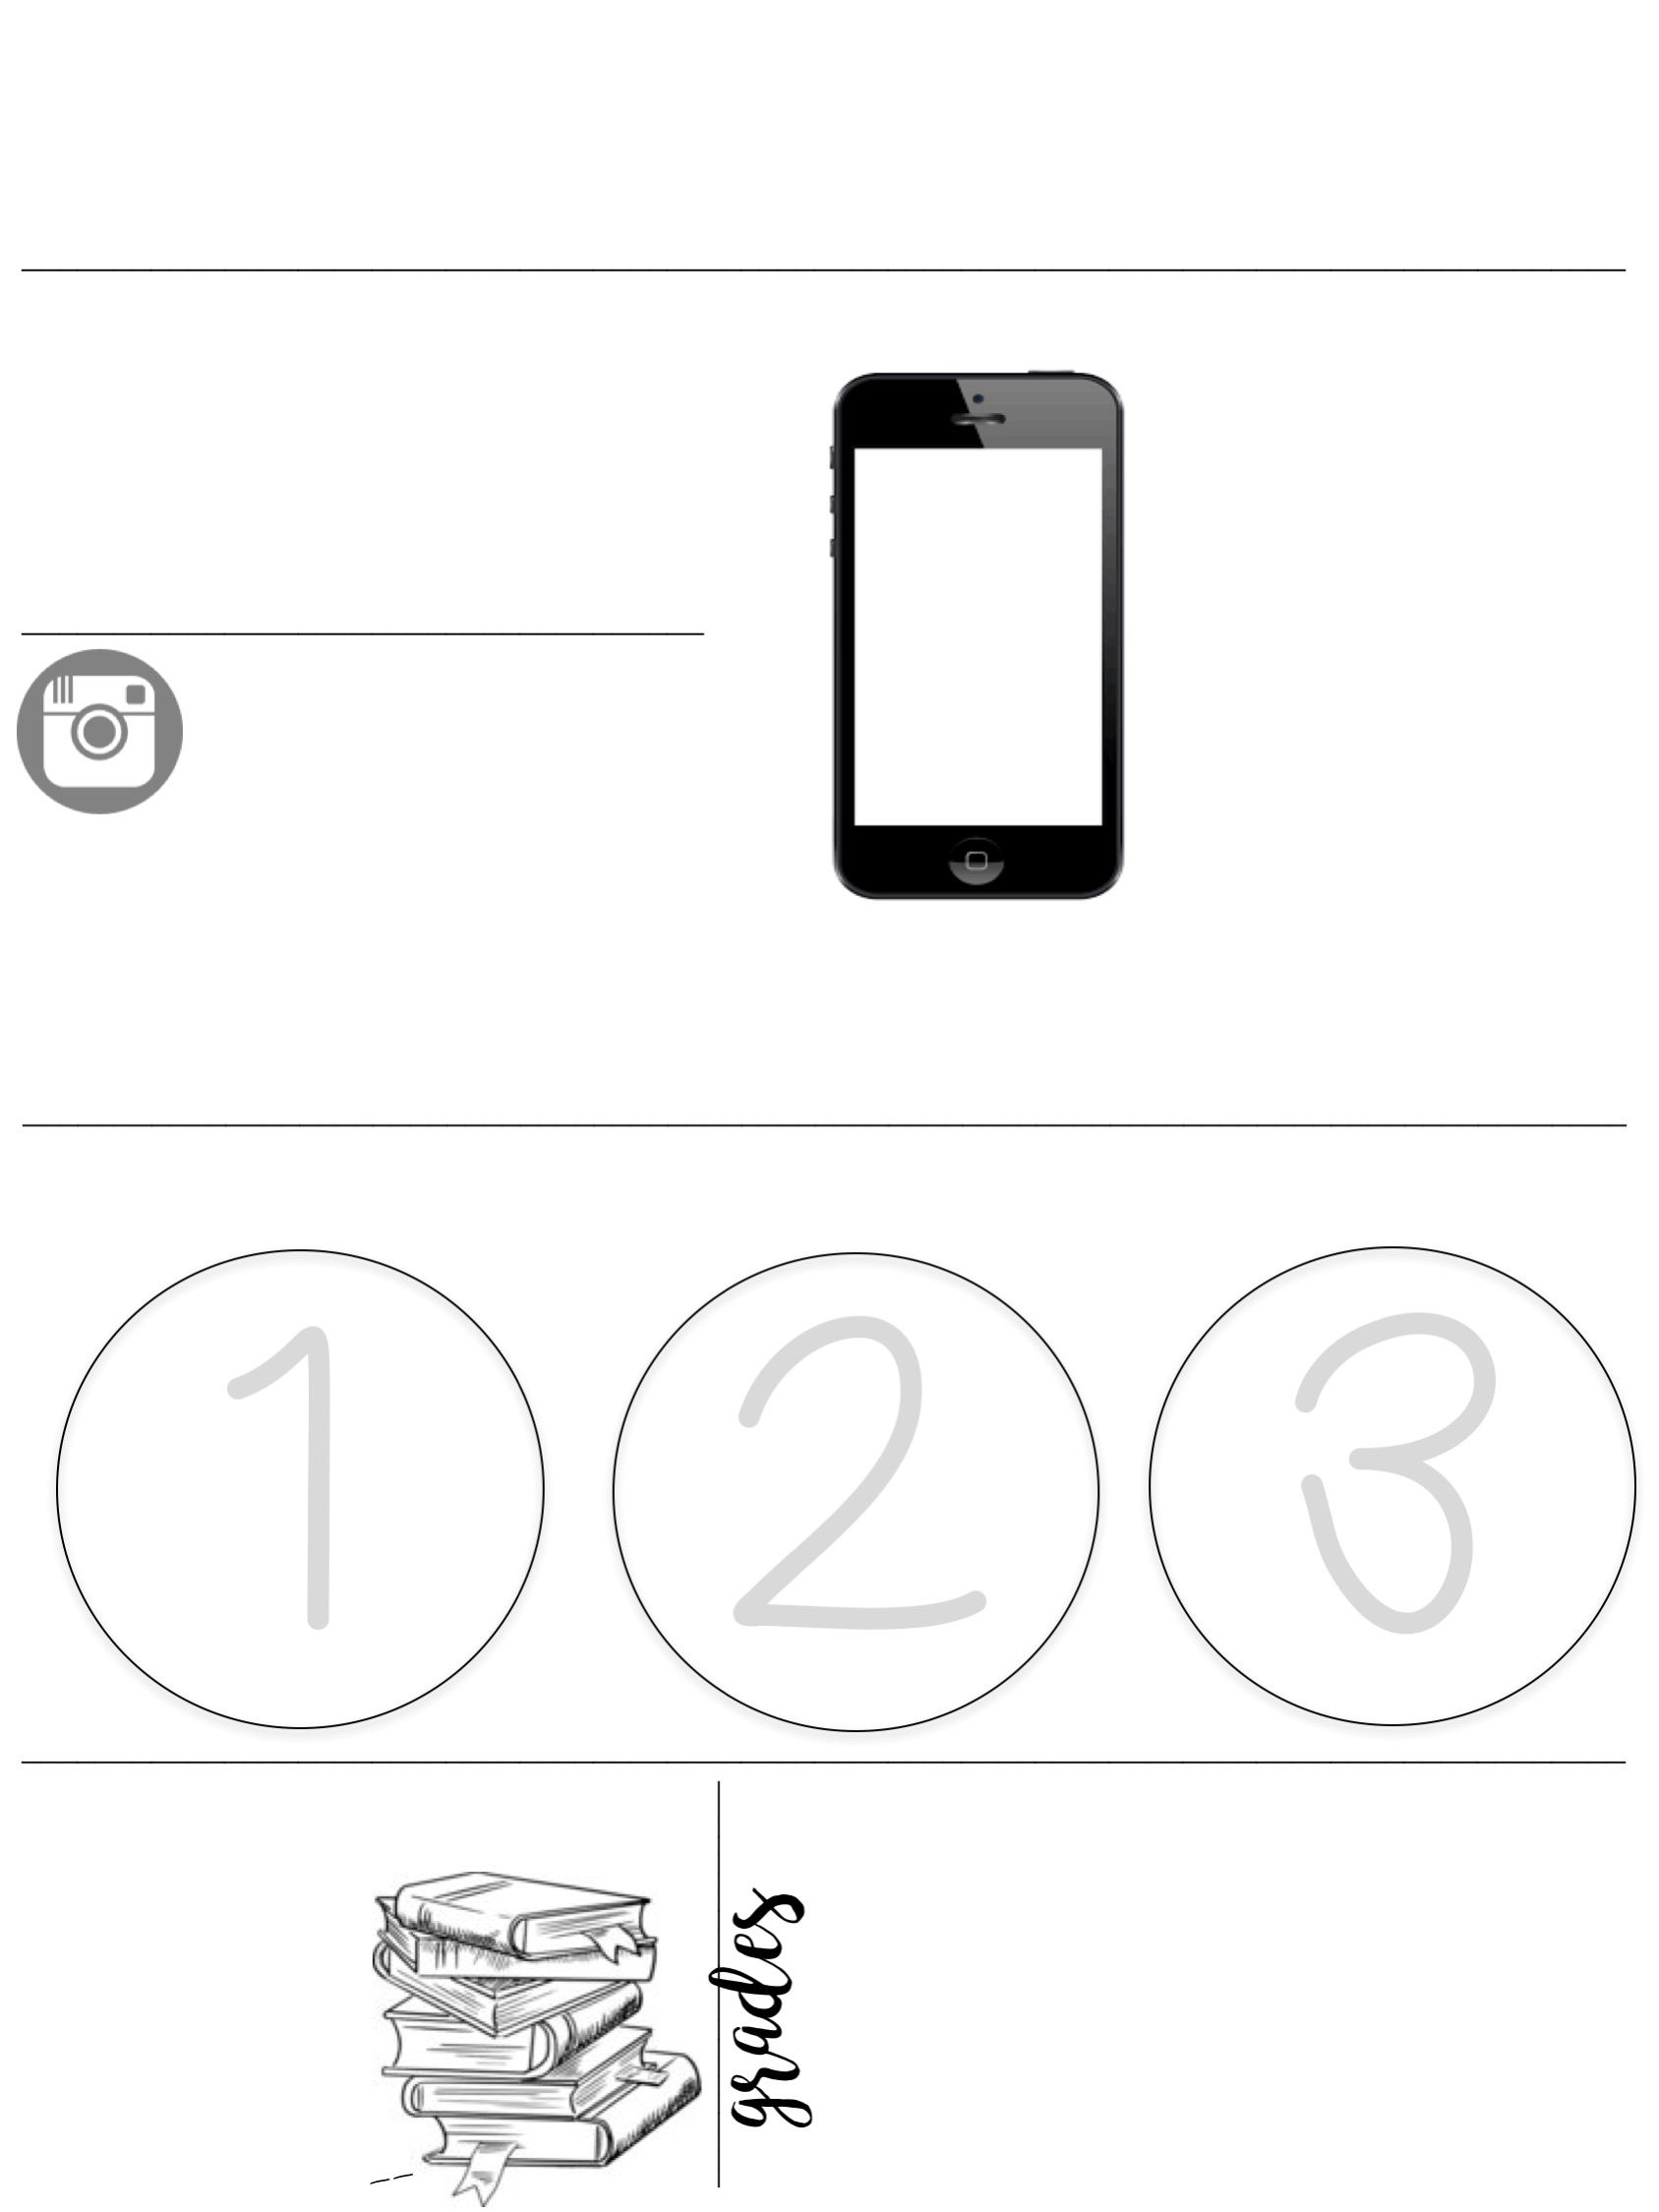
Middle School English
2016 -----
----- 2017
Mrs. Cahill
communication with the teacher
1 mcahill@school.org
2 Remind101 app chat
3 (719) 555-5555
eighth grade
Text @teacher to 5555
TEXT
MESSAGE ALERTS
seventh grade
Text @teacher to 5555
instagram
sixth grade
Text @teacher to 5555
@mrscahillsclass
@mrscahillsbooks
Follow our class account to see yourself and classmates in action.
Follow my book instagram for book recommendations.
Sign up for the class text alerts for updates on homework, tests, quizzes, and other important dates. Download the Remind App to be able to talk to Mrs. Cahill for help.
_______________________________________________________________________________________
responsibility and preparation
Start
working on
bell ringers immediately so class starts within 5 minutes of the bell. This is when I grade your bell ringers.
Come
prepared to
class with your binder, planner, notebooks, writing utensils, & interactive notebook supplies.
Work should
be turned in on its due date. Late work
will lose points on a per-day-late
basis.
_______________________________________________________________________________________
Class Materials
30%
20%
20%
20%
10%
2 composition notebooks
____
Pencils & pens
________
Tests & Quizzes
Reading Response
Bell ringers/daily Work
________
Papers
Projects
Participation
colored pencils,
scissors, glue
sticky notes, highlighters

Slide 7
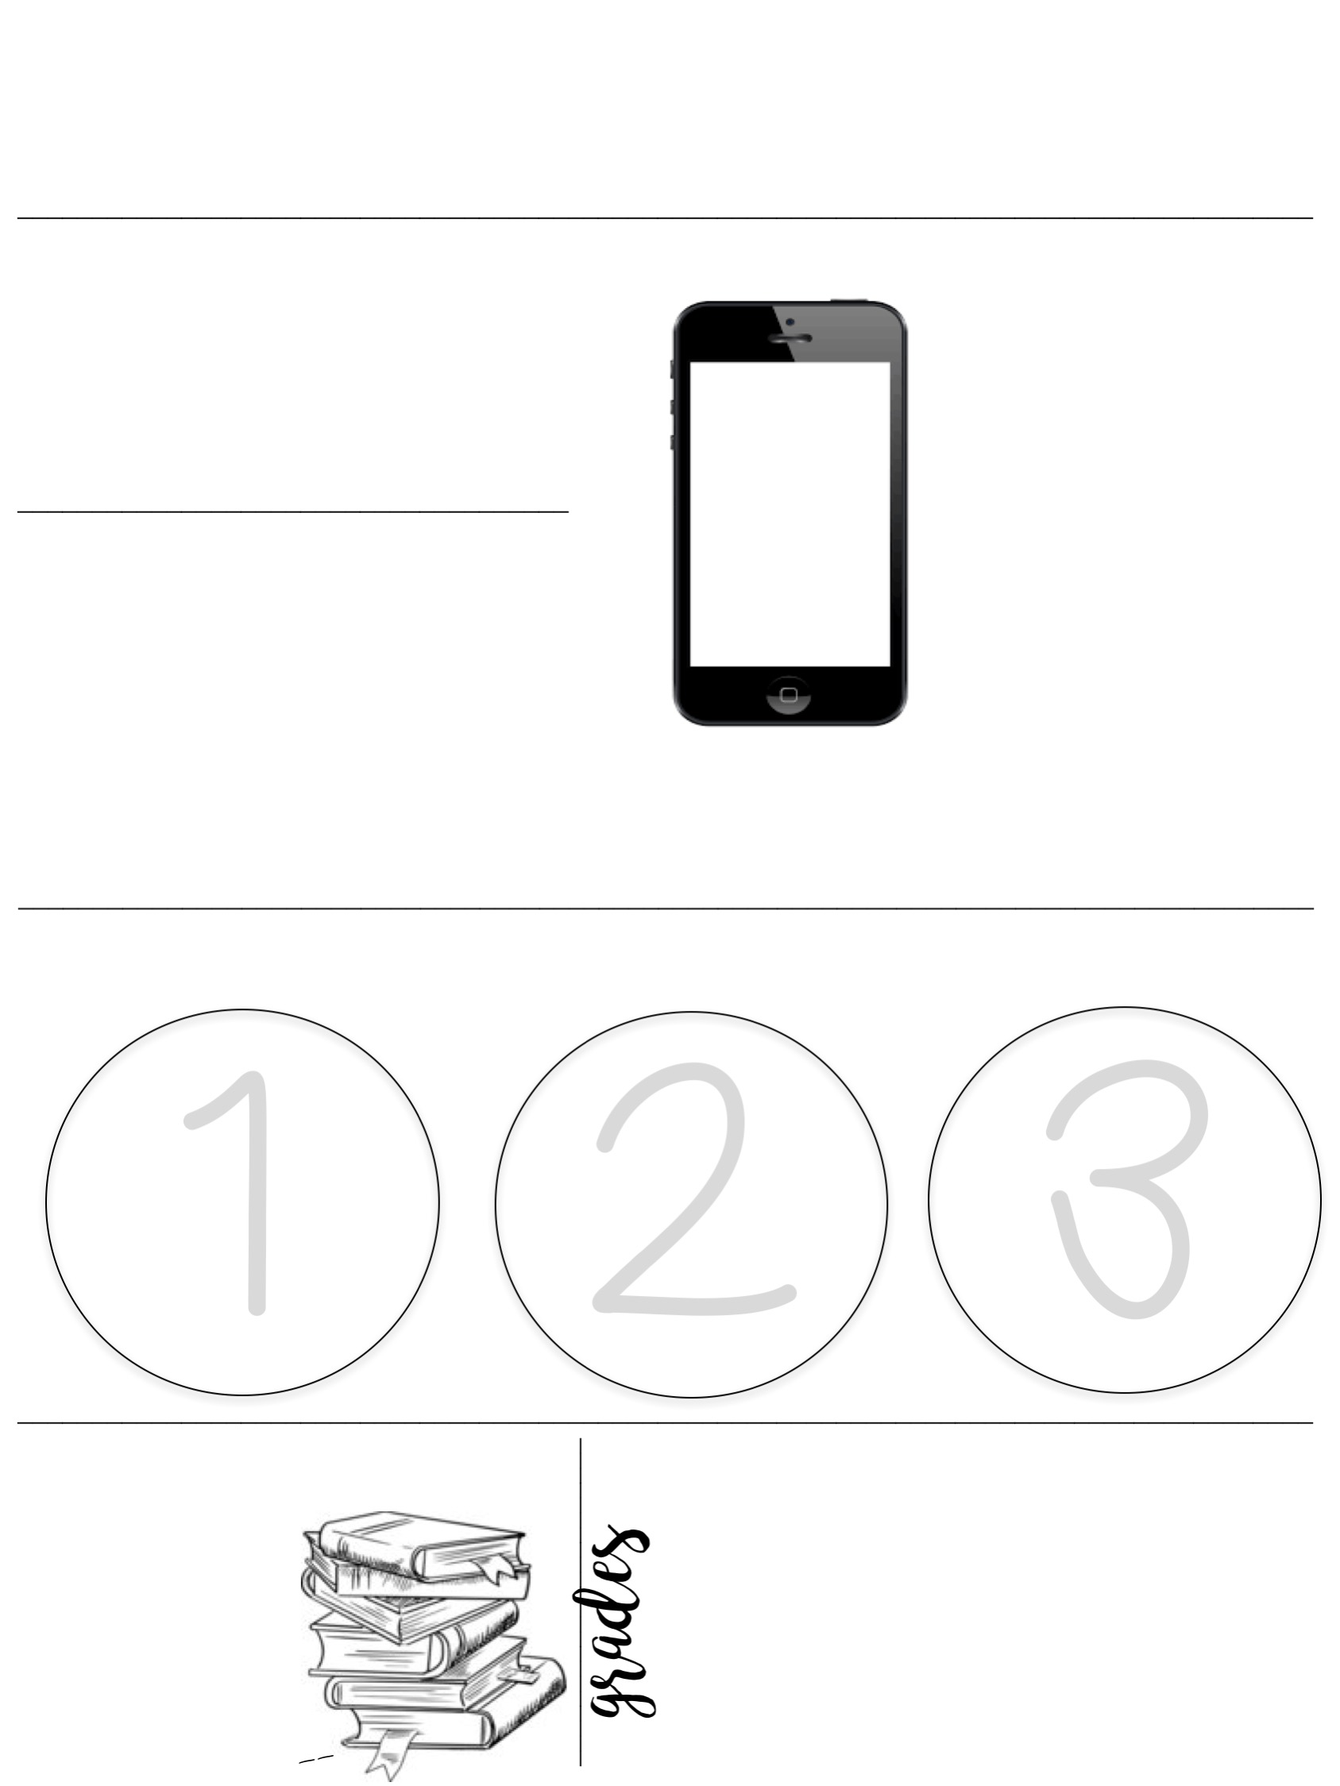
Middle School English
2016 -----
----- 2017
Mrs. Cahill
communication with the teacher
1 mcahill@school.org
2 Remind101 app chat
3 (719) 555-5555
eighth grade
Text @teacher to 5555
TEXT
MESSAGE ALERTS
seventh grade
Text @teacher to 5555
instagram
sixth grade
Text @teacher to 5555
@mrscahillsclass
@mrscahillsbooks
Follow our class account to see yourself and classmates in action.
Follow my book instagram for book recommendations.
Sign up for the class text alerts for updates on homework, tests, quizzes, and other important dates. Download the Remind App to be able to talk to Mrs. Cahill for help.
_______________________________________________________________________________________
responsibility and preparation
Start
working on
bell ringers immediately so class starts within 5 minutes of the bell. This is when I grade your bell ringers.
Come
prepared to
class with your binder, planner, notebooks, writing utensils, & interactive notebook supplies.
Work should
be turned in on its due date. Late work
will lose points on a per-day-late
basis.
_______________________________________________________________________________________
Class Materials
30%
20%
20%
20%
10%
2 composition notebooks
____
Pencils & pens
________
Tests & Quizzes
Reading Response
Bell ringers/daily Work
________
Papers
Projects
Participation
colored pencils,
scissors, glue
sticky notes, highlighters

Slide 8
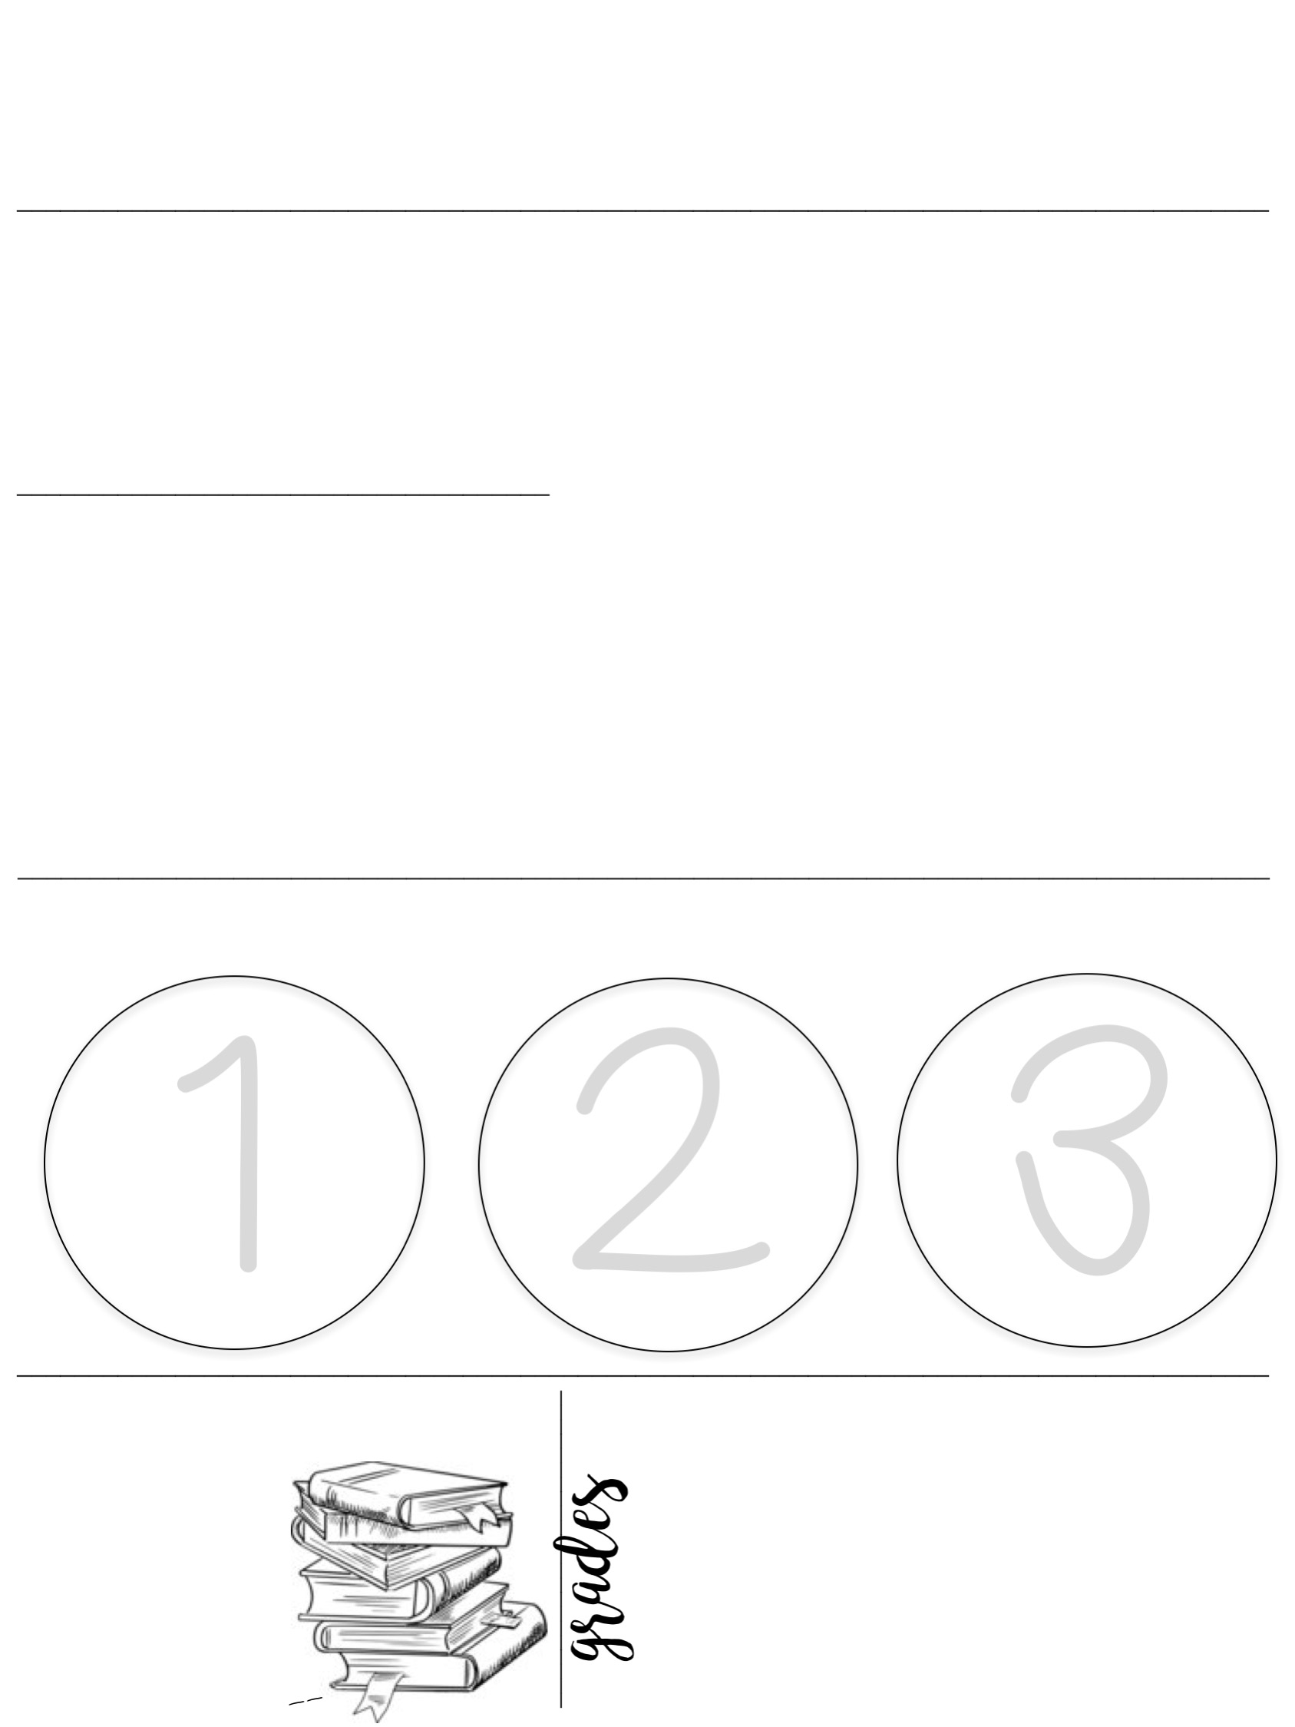
Middle School English
2016 -----
----- 2017
Mrs. Cahill
communication with the teacher
1 mcahill@school.org
2 Remind101 app chat
3 (719) 555-5555
eighth grade
Text @teacher to 5555
TEXT
MESSAGE ALERTS
seventh grade
Text @teacher to 5555
instagram
sixth grade
Text @teacher to 5555
@mrscahillsclass
@mrscahillsbooks
Follow our class account to see yourself and classmates in action.
Follow my book instagram for book recommendations.
Sign up for the class text alerts for updates on homework, tests, quizzes, and other important dates. Download the Remind App to be able to talk to Mrs. Cahill for help.
_______________________________________________________________________________________
responsibility and preparation
Start
working on
bell ringers immediately so class starts within 5 minutes of the bell. This is when I grade your bell ringers.
Come
prepared to
class with your binder, planner, notebooks, writing utensils, & interactive notebook supplies.
Work should
be turned in on its due date. Late work
will lose points on a per-day-late
basis.
_______________________________________________________________________________________
Class Materials
30%
20%
20%
20%
10%
2 composition notebooks
____
Pencils & pens
________
Tests & Quizzes
Reading Response
Bell ringers/daily Work
________
Papers
Projects
Participation
colored pencils,
scissors, glue
sticky notes, highlighters

Slide 9
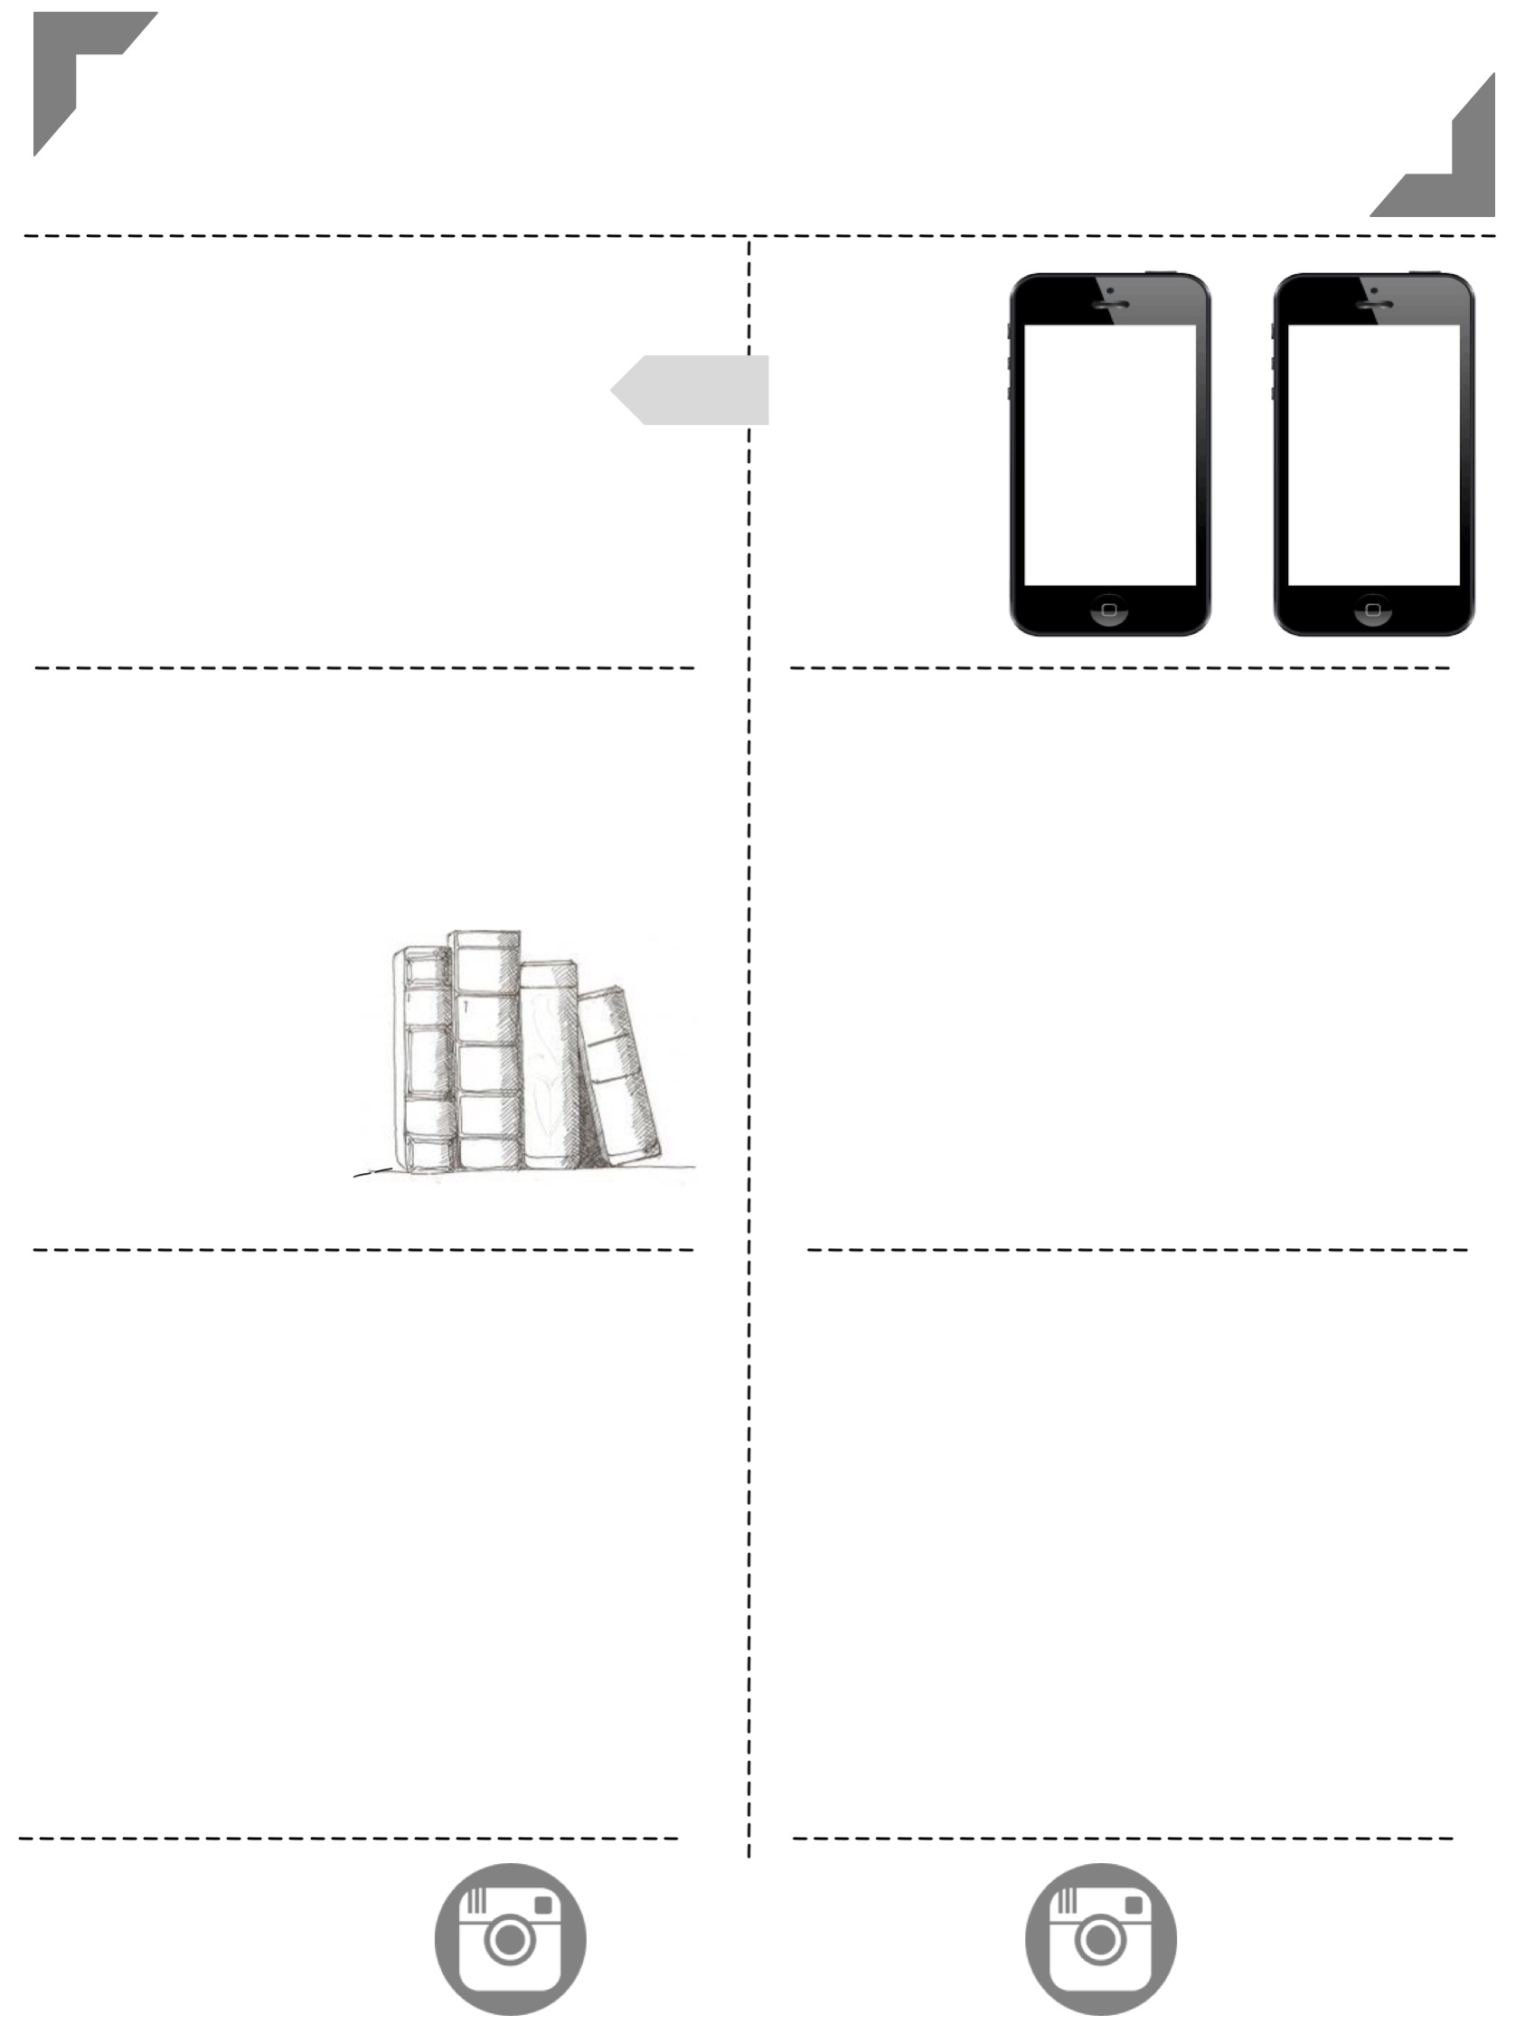
Middle School English
Mrs. Cahill
2016 -----
----- 2017
-----------------------------------------------------------------------
-----------------------------------------------------------------------
communication
with the teacher
1 mcahill@school.org
2 Remind101 app chat
3 (719) 555-5555
Text Message Alerts
eighth
grade
seventh
grade
Text @teacher
to 5555
Text @teacher
to 5555
---------------------------------
---------------------------------
---------------------------------
---------------------------------
class materials
preparation
1
2
3
Come prepared to class with your binder, planner, notebooks, writing utensils, & interactive notebook supplies.
Start working on bell ringers immediately so class can start within five minutes of the bell. This is when I will grade your bell ringers.
Work should be turned in on its due date. Late work
will lose points on a per-day-late basis.
2 composition notebooks
______
Pencils & pens
___________
colored pencils,
scissors, glue
________
sticky notes, highlighters
__
grades
responsibility
30%
20%
20%
20%
10%
Weekly and daily work will be updated weekly (bell ringers, participation, and quizzes). Please check grades regularly and feel free to ask me any questions that you might have about a particular grade.
If you are absent, you are responsible for completing your make-up work (one day for make-up for each day absent).
This can be done before or after school or via e-mail.
Papers
Projects
Reading Response
Bell ringers/daily Work
Tests & Quizzes
Participation
---------------------------------
---------------------------------
instagram
@mrscahillsclass
@mrscahillsbooks
Follow our class account
to see yourself and classmates in action.
Follow my book instagram for book recommendations.

Slide 10
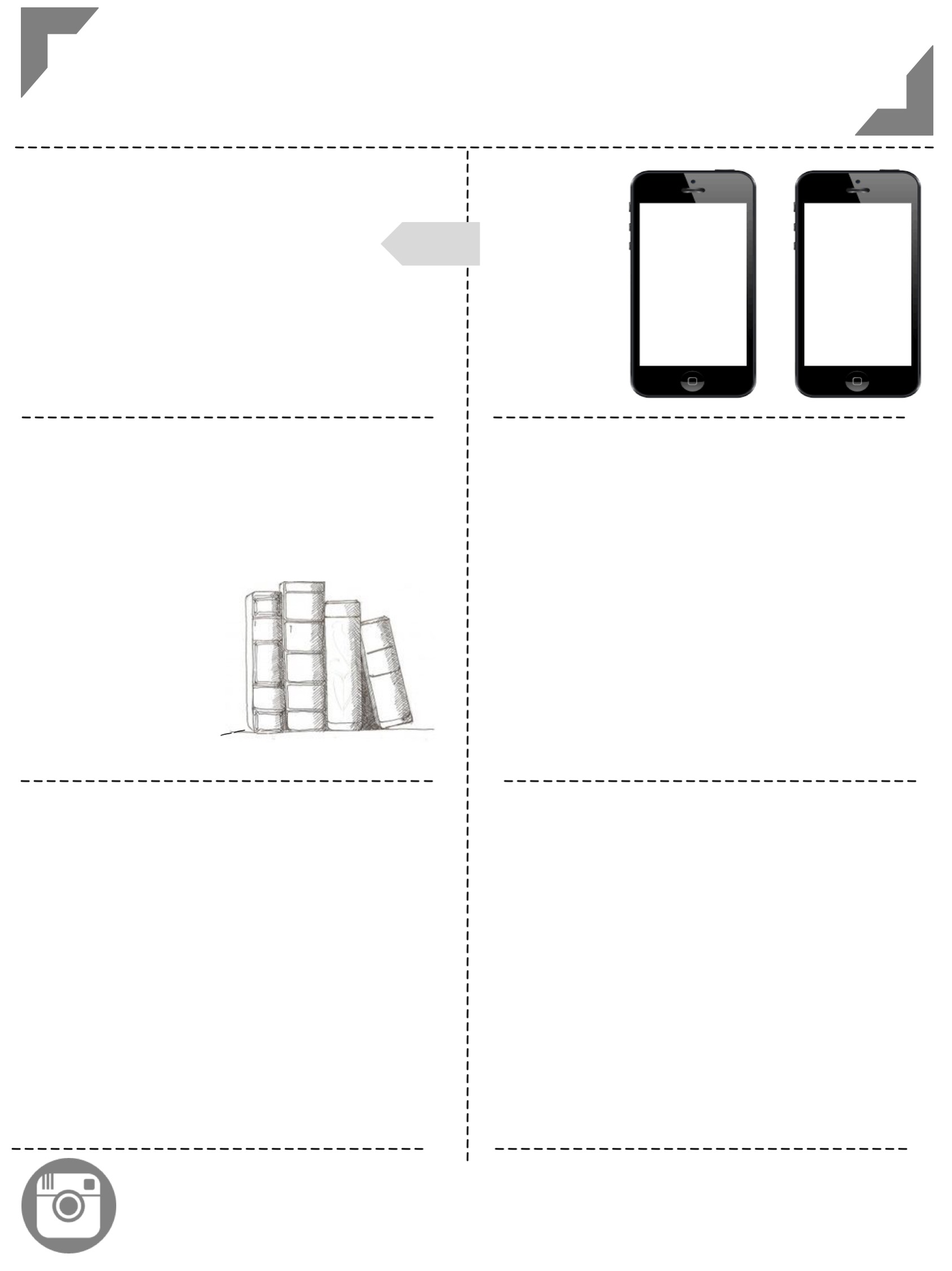
Middle School English
Mrs. Cahill
2016 -----
----- 2017
-----------------------------------------------------------------------
-----------------------------------------------------------------------
communication
with the teacher
1 mcahill@school.org
2 Remind101 app chat
3 (719) 555-5555
Text Message Alerts
eighth
grade
seventh
grade
Text @teacher
to 5555
Text @teacher
to 5555
---------------------------------
---------------------------------
---------------------------------
---------------------------------
class materials
preparation
1
2
3
Come prepared to class with your binder, planner, notebooks, writing utensils, & interactive notebook supplies.
Start working on bell ringers immediately so class can start within five minutes of the bell. This is when I will grade your bell ringers.
Work should be turned in on its due date. Late work
will lose points on a per-day-late basis.
2 composition notebooks
______
Pencils & pens
___________
colored pencils,
scissors, glue
________
sticky notes, highlighters
__
grades
responsibility
30%
20%
20%
20%
10%
Weekly and daily work will be updated weekly (bell ringers, participation, and quizzes). Please check grades regularly and feel free to ask me any questions that you might have about a particular grade.
If you are absent, you are responsible for completing your make-up work (one day for make-up for each day absent).
This can be done before or after school or via e-mail.
Papers
Projects
Reading Response
Bell ringers/daily Work
Tests & Quizzes
Participation
---------------------------------
---------------------------------
instagram
@mrscahillsclass
@mrscahillsbooks
Follow our class account
to see yourself and classmates in action.
Follow my book instagram for book recommendations.

Slide 11
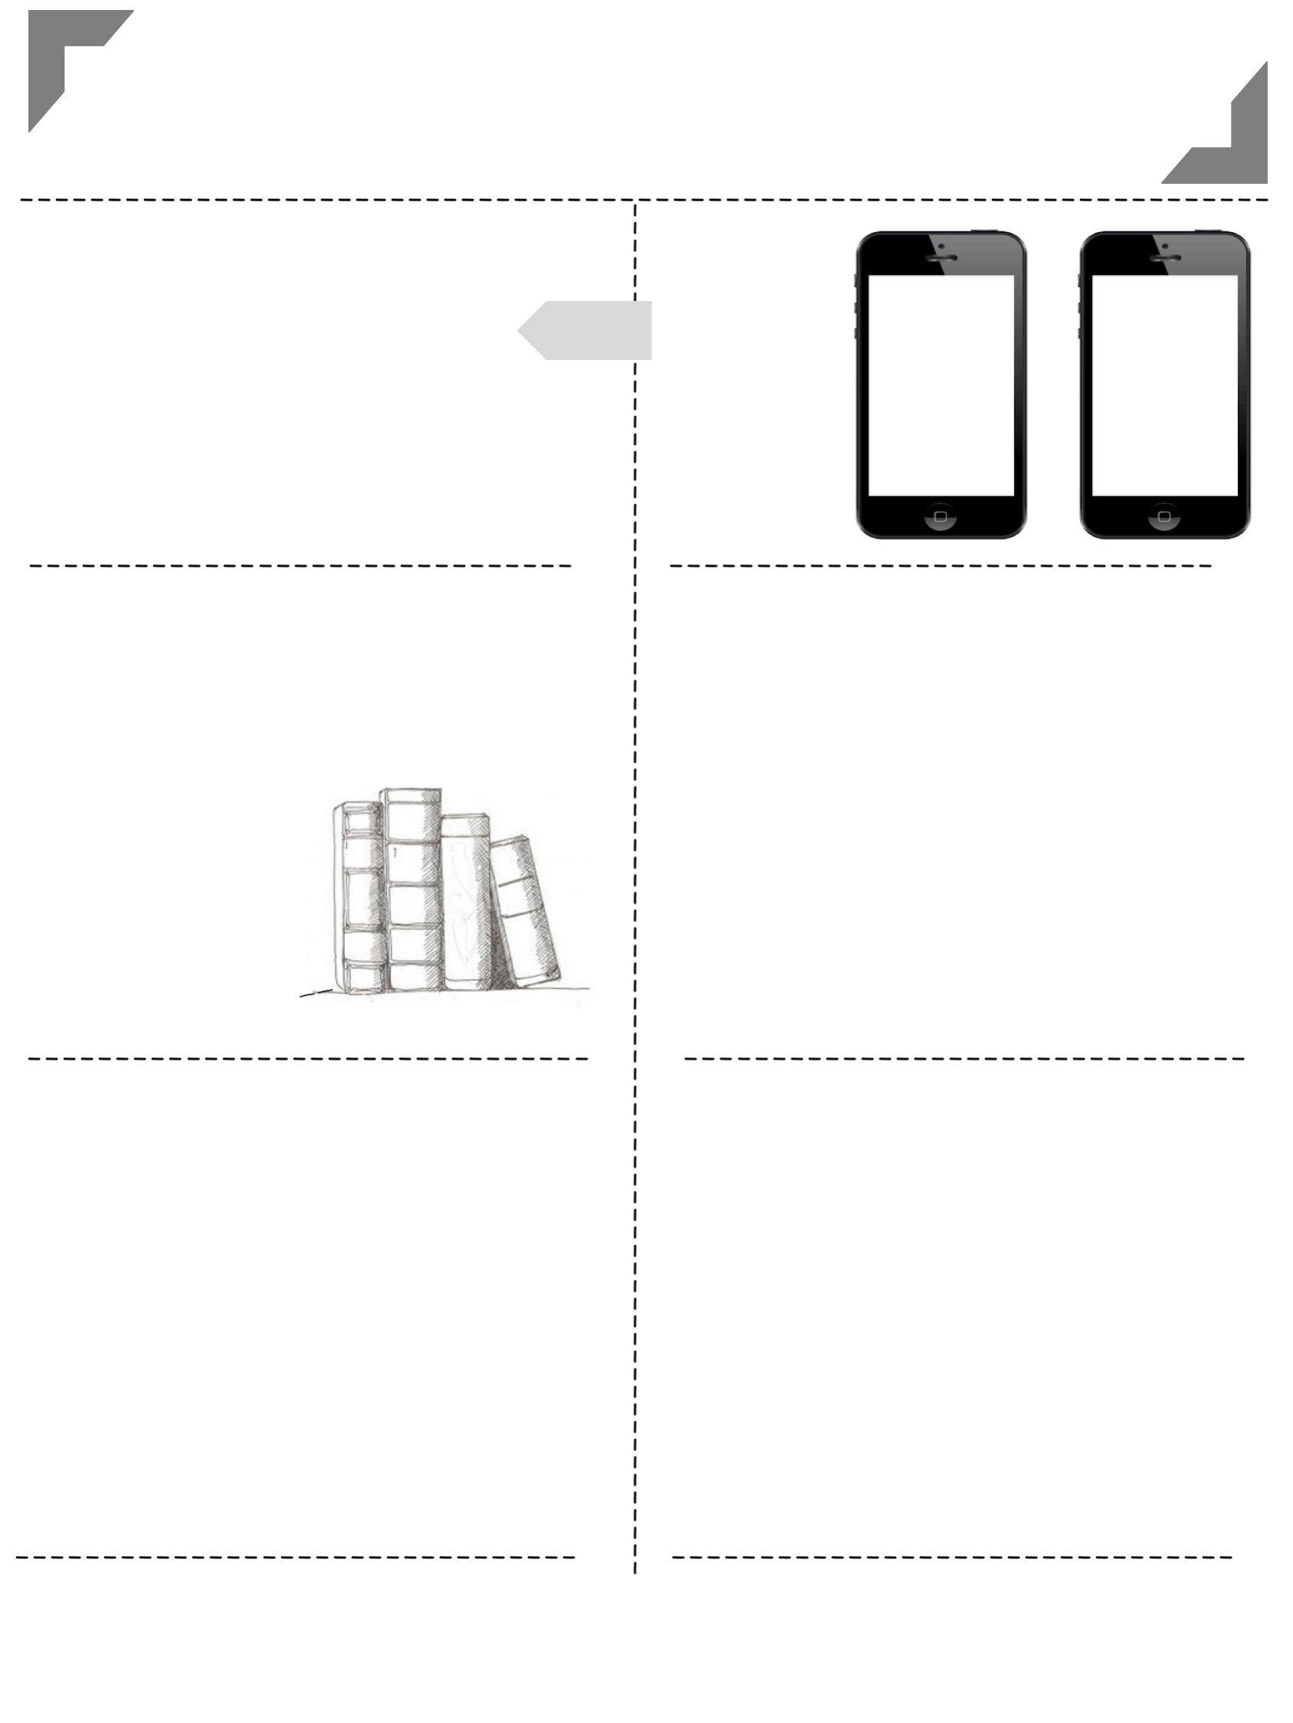
Middle School English
Mrs. Cahill
2016 -----
----- 2017
-----------------------------------------------------------------------
-----------------------------------------------------------------------
communication
with the teacher
1 mcahill@school.org
2 Remind101 app chat
3 (719) 555-5555
Text Message Alerts
eighth
grade
seventh
grade
Text @teacher
to 5555
Text @teacher
to 5555
---------------------------------
---------------------------------
---------------------------------
---------------------------------
class materials
preparation
1
2
3
Come prepared to class with your binder, planner, notebooks, writing utensils, & interactive notebook supplies.
Start working on bell ringers immediately so class can start within five minutes of the bell. This is when I will grade your bell ringers.
Work should be turned in on its due date. Late work
will lose points on a per-day-late basis.
2 composition notebooks
______
Pencils & pens
___________
colored pencils,
scissors, glue
________
sticky notes, highlighters
__
grades
responsibility
30%
20%
20%
20%
10%
Weekly and daily work will be updated weekly (bell ringers, participation, and quizzes). Please check grades regularly and feel free to ask me any questions that you might have about a particular grade.
If you are absent, you are responsible for completing your make-up work (one day for make-up for each day absent).
This can be done before or after school or via e-mail.
Papers
Projects
Reading Response
Bell ringers/daily Work
Tests & Quizzes
Participation
---------------------------------
---------------------------------
instagram
@mrscahillsclass
@mrscahillsbooks
Follow our class account
to see yourself and classmates in action.
Follow my book instagram for book recommendations.

Slide 12
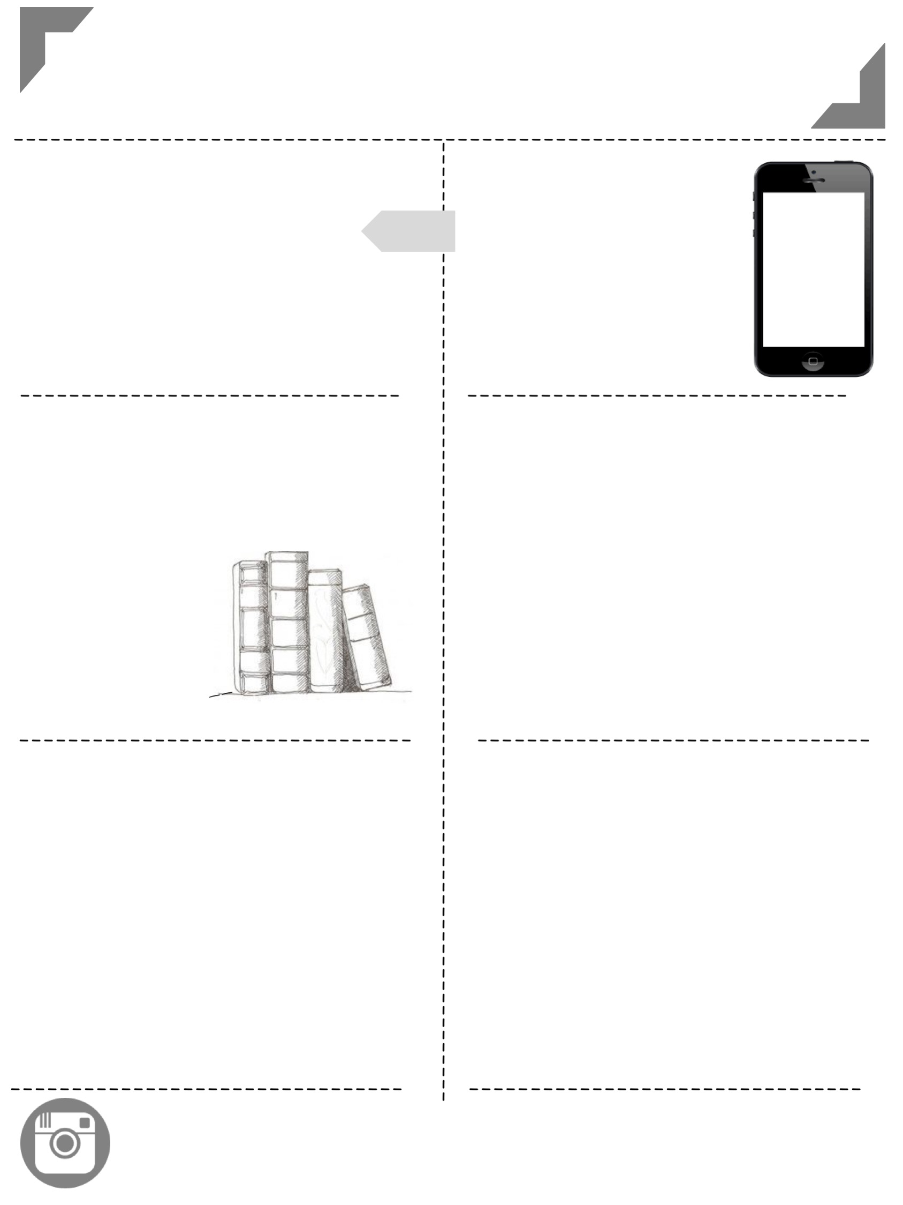
Middle School English
Mrs. Cahill
2016 -----
----- 2017
-----------------------------------------------------------------------
-----------------------------------------------------------------------
communication
with the teacher
1 mcahill@school.org
2 Remind101 app chat
3 (719) 555-5555
Text Message Alerts
eighth
grade
seventh
grade
Text @teacher
to 5555
Text @teacher
to 5555
---------------------------------
---------------------------------
---------------------------------
---------------------------------
class materials
preparation
1
2
3
Come prepared to class with your binder, planner, notebooks, writing utensils, & interactive notebook supplies.
Start working on bell ringers immediately so class can start within five minutes of the bell. This is when I will grade your bell ringers.
Work should be turned in on its due date. Late work
will lose points on a per-day-late basis.
2 composition notebooks
______
Pencils & pens
___________
colored pencils,
scissors, glue
________
sticky notes, highlighters
__
grades
responsibility
30%
20%
20%
20%
10%
Weekly and daily work will be updated weekly (bell ringers, participation, and quizzes). Please check grades regularly and feel free to ask me any questions that you might have about a particular grade.
If you are absent, you are responsible for completing your make-up work (one day for make-up for each day absent).
This can be done before or after school or via e-mail.
Papers
Projects
Reading Response
Bell ringers/daily Work
Tests & Quizzes
Participation
---------------------------------
---------------------------------
instagram
@mrscahillsclass
@mrscahillsbooks
Follow our class account
to see yourself and classmates in action.
Follow my book instagram for book recommendations.

Slide 13
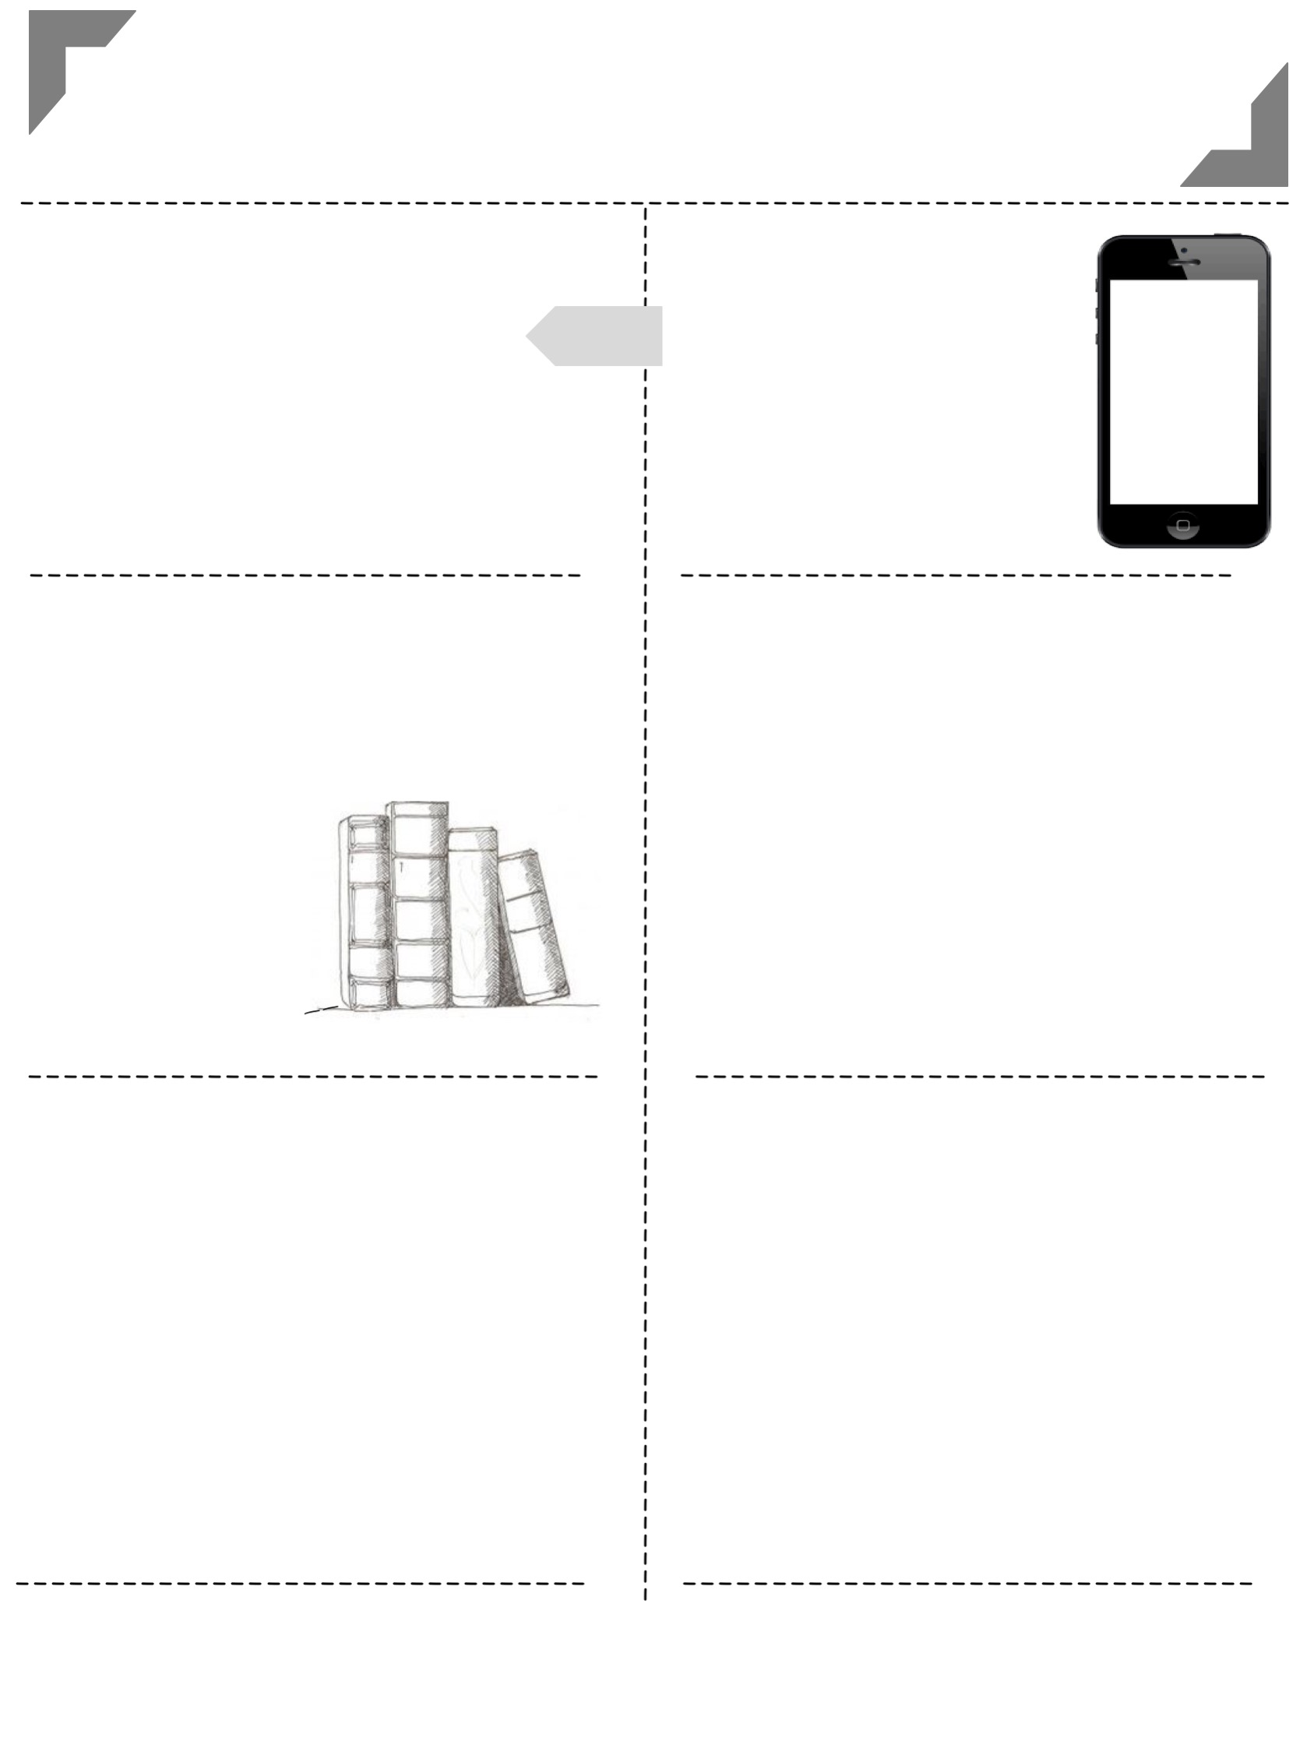
Middle School English
Mrs. Cahill
2016 -----
----- 2017
-----------------------------------------------------------------------
-----------------------------------------------------------------------
communication
with the teacher
1 mcahill@school.org
2 Remind101 app chat
3 (719) 555-5555
Text Message Alerts
eighth
grade
seventh
grade
Text @teacher
to 5555
Text @teacher
to 5555
---------------------------------
---------------------------------
---------------------------------
---------------------------------
class materials
preparation
1
2
3
Come prepared to class with your binder, planner, notebooks, writing utensils, & interactive notebook supplies.
Start working on bell ringers immediately so class can start within five minutes of the bell. This is when I will grade your bell ringers.
Work should be turned in on its due date. Late work
will lose points on a per-day-late basis.
2 composition notebooks
______
Pencils & pens
___________
colored pencils,
scissors, glue
________
sticky notes, highlighters
__
grades
responsibility
30%
20%
20%
20%
10%
Weekly and daily work will be updated weekly (bell ringers, participation, and quizzes). Please check grades regularly and feel free to ask me any questions that you might have about a particular grade.
If you are absent, you are responsible for completing your make-up work (one day for make-up for each day absent).
This can be done before or after school or via e-mail.
Papers
Projects
Reading Response
Bell ringers/daily Work
Tests & Quizzes
Participation
---------------------------------
---------------------------------
instagram
@mrscahillsclass
@mrscahillsbooks
Follow our class account
to see yourself and classmates in action.
Follow my book instagram for book recommendations.

Slide 14
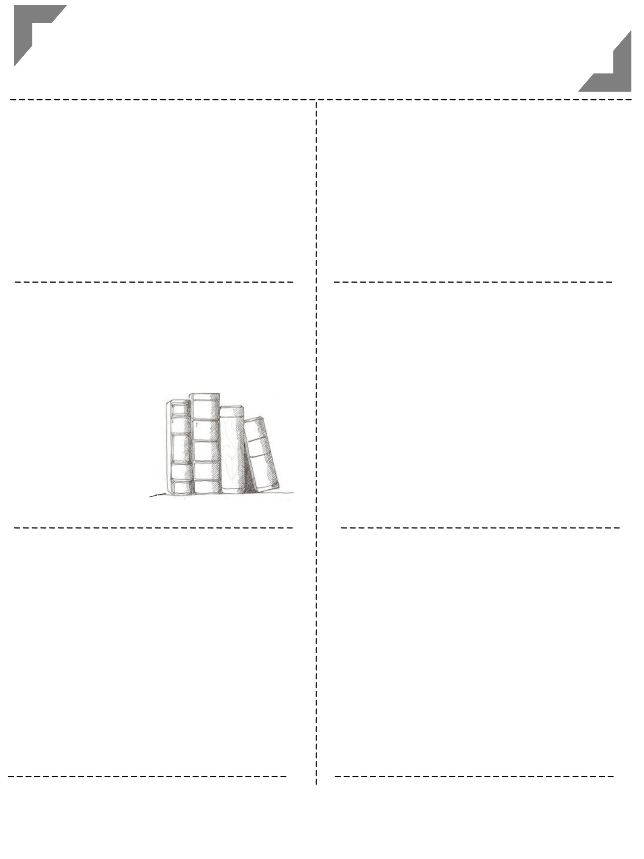
Middle School ELA
Stanaway
2018/19
-----------------------------------------------------------------------
-----------------------------------------------------------------------
communication
with the teacher
1 jstanaway@wcskids.net
2 825-2590 ext 28314
Lesson Plan Page
juliestanaway.weebly.com
---------------------------------
---------------------------------
---------------------------------
---------------------------------
class materials
preparation
1
2
3
Come prepared to class with your binder, planner, notebooks, writing utensils, & IDR book.
Start working on attendance questions immediately so class can start within five minutes of the bell. They will be collected weekly.
Work should be turned in on its due date. Late work may be penalized.
notebooks
______
pencils & pens
_________
IDR book
________
sticky notes, highlighters
grades
responsibility
75%
25%
Weekly and daily work will be updated regularly. Please check grades regularly and feel free to ask me any questions that you might have about a particular grade.
If you are absent, you are responsible for completing your make-up work (one day for make-up for each day absent). Check the rainbow folders for any handouts
Papers
Projects
Reading Response
Bell ringers/daily Work
Tests & Quizzes
Participation
---------------------------------
---------------------------------
Try a little harder to be a little better!!

Slide 15
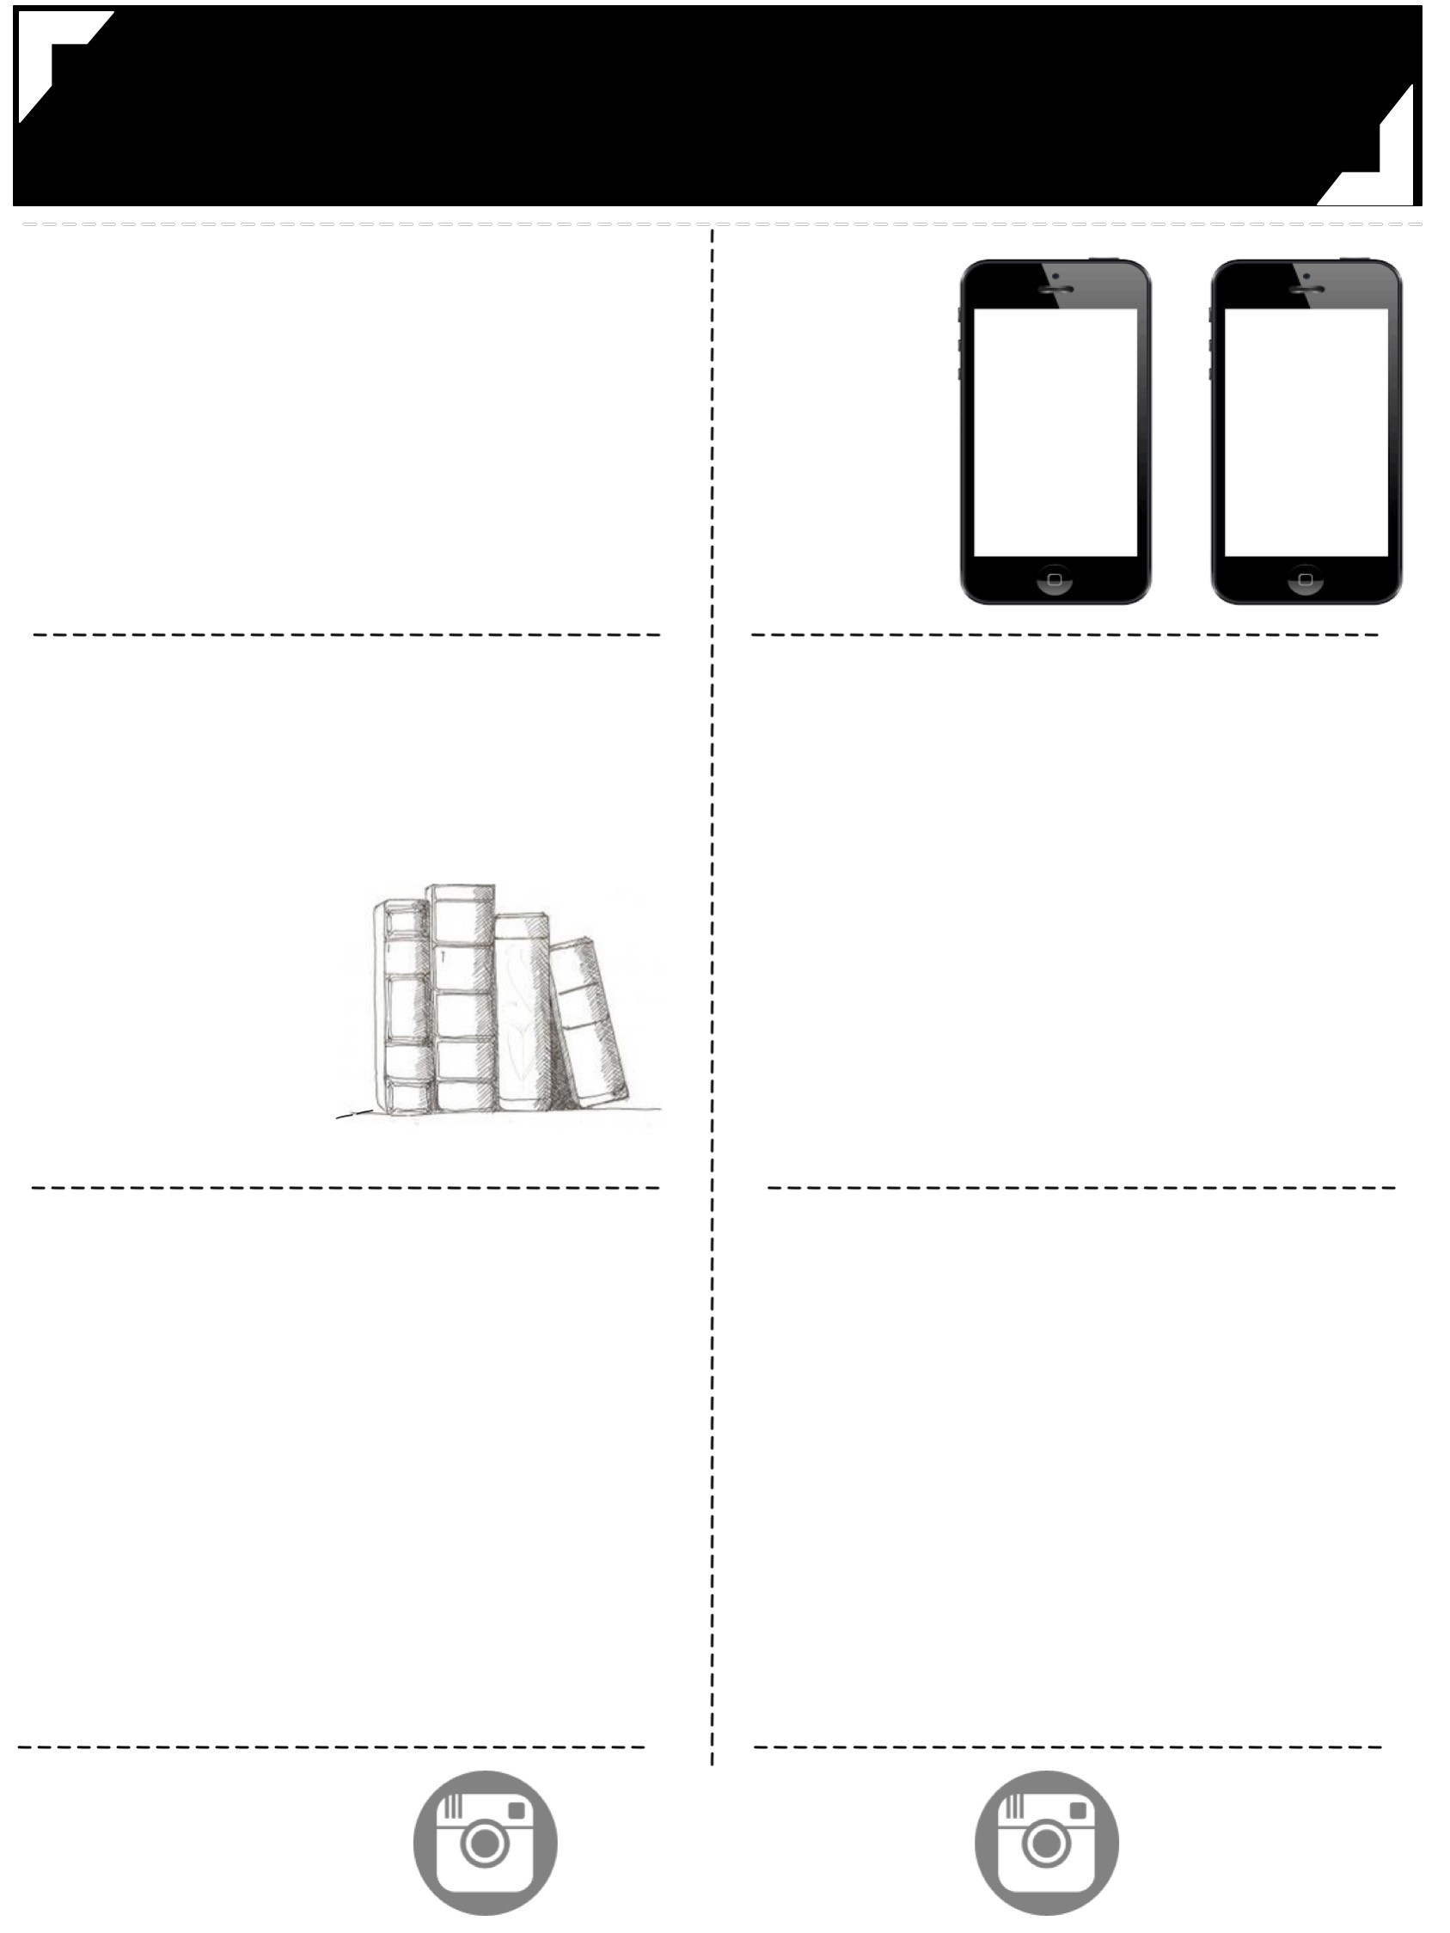
Middle School English
Mrs. Cahill
2016 -------
------- 2017
-----------------------------------------------------------------------
-----------------------------------------------------------------------
communication
with the teacher
1 mcahill@school.org
2 Remind101 app chat
3 (719) 555-5555
Text Message Alerts
eighth
grade
seventh
grade
Text @teacher
to 5555
Text @teacher
to 5555
---------------------------------
---------------------------------
---------------------------------
---------------------------------
class materials
preparation
1
2
3
Come prepared to class with your binder, planner, notebooks, writing utensils, & interactive notebook supplies.
Start working on bell ringers immediately so class can start within five minutes of the bell. This is when I will grade your bell ringers.
Work should be turned in on its due date. Late work
will lose points on a per-day-late basis.
2 composition notebooks
______
Pencils & pens
___________
colored pencils,
scissors, glue
________
sticky notes, highlighters
__
grades
responsibility
30%
20%
20%
20%
10%
Weekly and daily work will be updated weekly (bell ringers, participation, and quizzes). Please check grades regularly and feel free to ask me any questions that you might have about a particular grade.
If you are absent, you are responsible for completing your make-up work (one day for make-up for each day absent).
This can be done before or after school or via e-mail.
Papers
Projects
Reading Response
Bell ringers/daily Work
Tests & Quizzes
Participation
---------------------------------
---------------------------------
---------------------------------
---------------------------------
instagram
@mrscahillsclass
@mrscahillsbooks
Follow our class account
to see yourself and classmates in action.
Follow my book instagram for book recommendations.

Slide 16
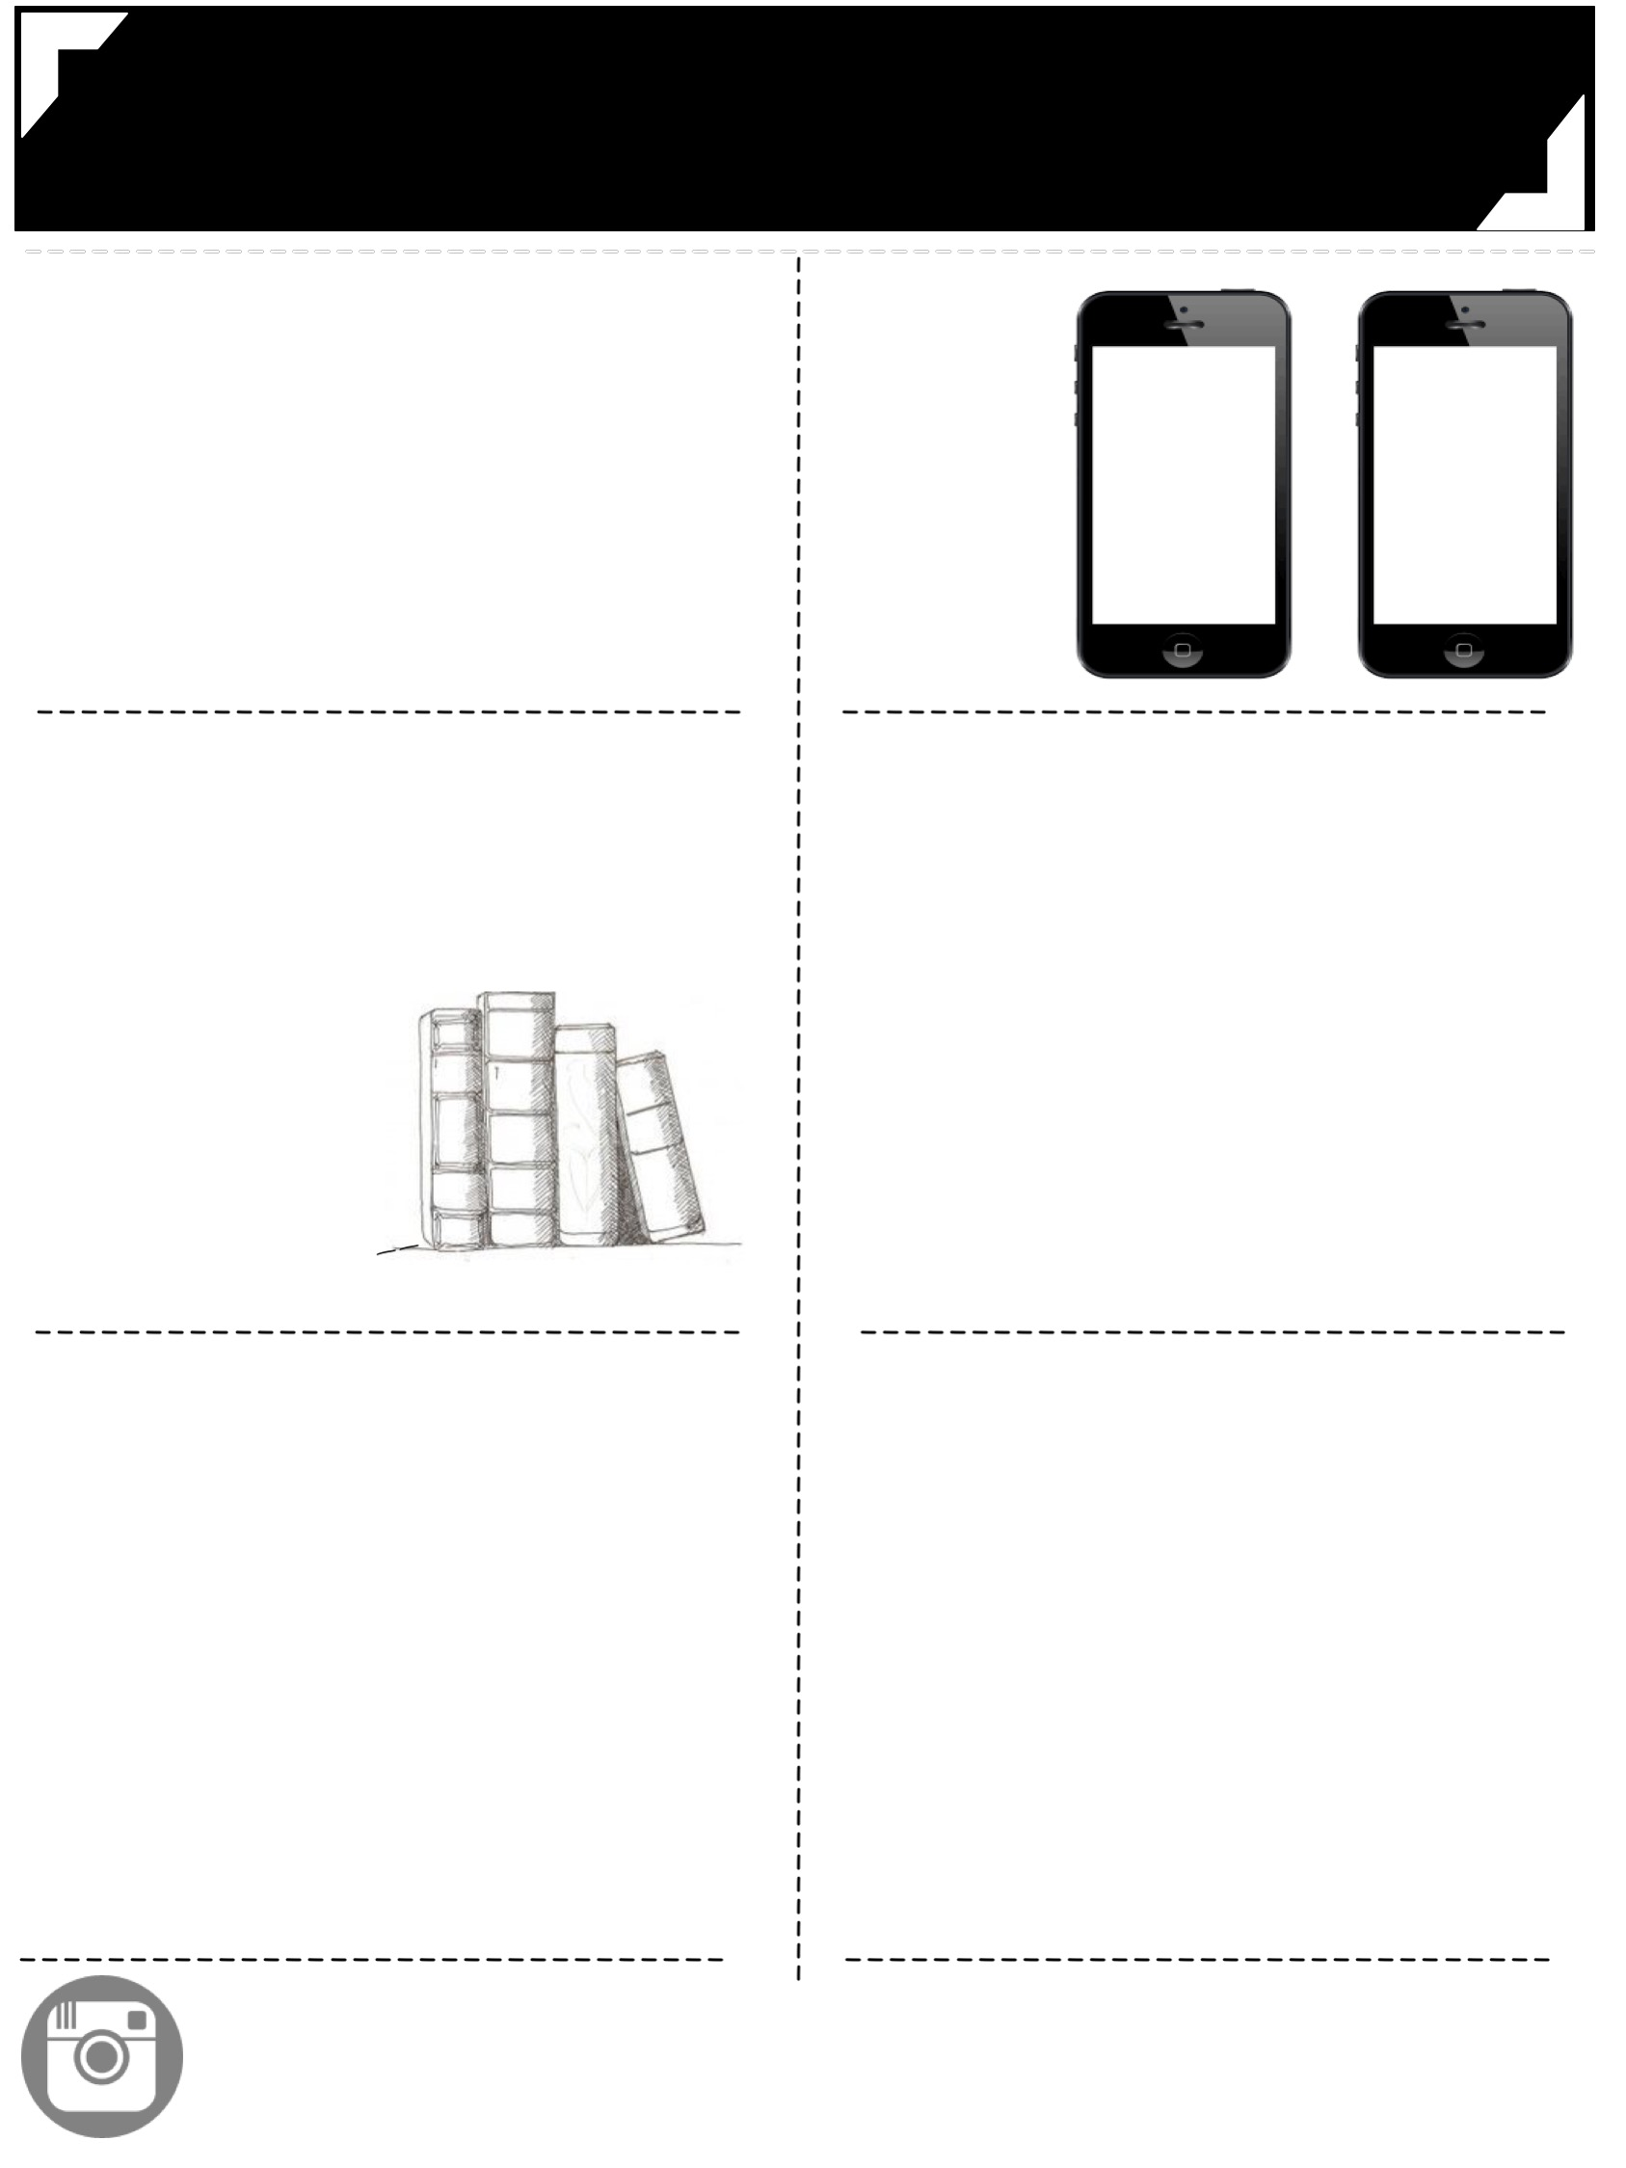
Middle School English
Mrs. Cahill
2016 -------
------- 2017
-----------------------------------------------------------------------
-----------------------------------------------------------------------
communication
with the teacher
1 mcahill@school.org
2 Remind101 app chat
3 (719) 555-5555
Text Message Alerts
eighth
grade
seventh
grade
Text @teacher
to 5555
Text @teacher
to 5555
---------------------------------
---------------------------------
---------------------------------
---------------------------------
class materials
preparation
1
2
3
Come prepared to class with your binder, planner, notebooks, writing utensils, & interactive notebook supplies.
Start working on bell ringers immediately so class can start within five minutes of the bell. This is when I will grade your bell ringers.
Work should be turned in on its due date. Late work
will lose points on a per-day-late basis.
2 composition notebooks
______
Pencils & pens
___________
colored pencils,
scissors, glue
________
sticky notes, highlighters
__
grades
responsibility
30%
20%
20%
20%
10%
Weekly and daily work will be updated weekly (bell ringers, participation, and quizzes). Please check grades regularly and feel free to ask me any questions that you might have about a particular grade.
If you are absent, you are responsible for completing your make-up work (one day for make-up for each day absent).
This can be done before or after school or via e-mail.
Papers
Projects
Reading Response
Bell ringers/daily Work
Tests & Quizzes
Participation
---------------------------------
---------------------------------
---------------------------------
---------------------------------
instagram
@mrscahillsclass
@mrscahillsbooks
Follow our class account
to see yourself and classmates in action.
Follow my book instagram for book recommendations.

Slide 17
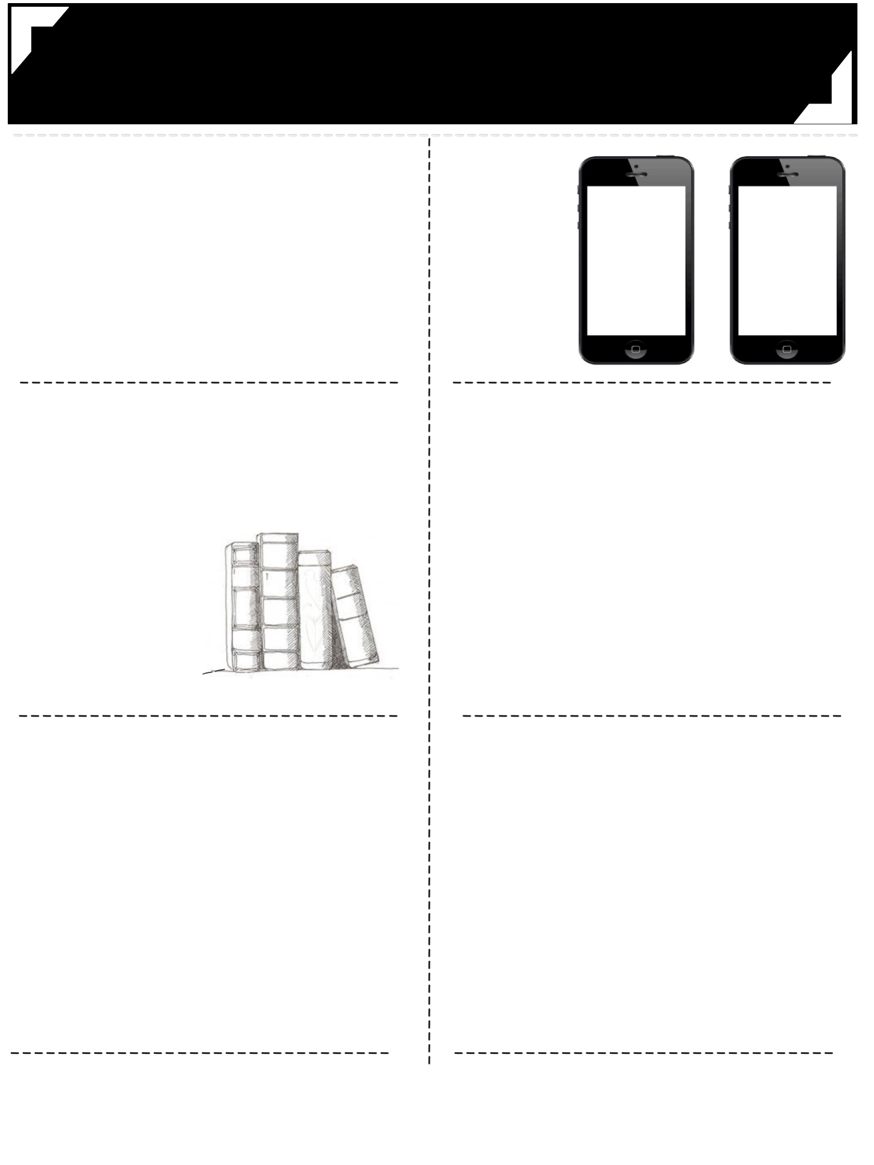
Middle School English
Mrs. Cahill
2016 -------
------- 2017
-----------------------------------------------------------------------
-----------------------------------------------------------------------
communication
with the teacher
1 mcahill@school.org
2 Remind101 app chat
3 (719) 555-5555
Text Message Alerts
eighth
grade
seventh
grade
Text @teacher
to 5555
Text @teacher
to 5555
---------------------------------
---------------------------------
---------------------------------
---------------------------------
class materials
preparation
1
2
3
Come prepared to class with your binder, planner, notebooks, writing utensils, & interactive notebook supplies.
Start working on bell ringers immediately so class can start within five minutes of the bell. This is when I will grade your bell ringers.
Work should be turned in on its due date. Late work
will lose points on a per-day-late basis.
2 composition notebooks
______
Pencils & pens
___________
colored pencils,
scissors, glue
________
sticky notes, highlighters
__
grades
responsibility
30%
20%
20%
20%
10%
Weekly and daily work will be updated weekly (bell ringers, participation, and quizzes). Please check grades regularly and feel free to ask me any questions that you might have about a particular grade.
If you are absent, you are responsible for completing your make-up work (one day for make-up for each day absent).
This can be done before or after school or via e-mail.
Papers
Projects
Reading Response
Bell ringers/daily Work
Tests & Quizzes
Participation
---------------------------------
---------------------------------
---------------------------------
---------------------------------
instagram
@mrscahillsclass
@mrscahillsbooks
Follow our class account
to see yourself and classmates in action.
Follow my book instagram for book recommendations.

Slide 18
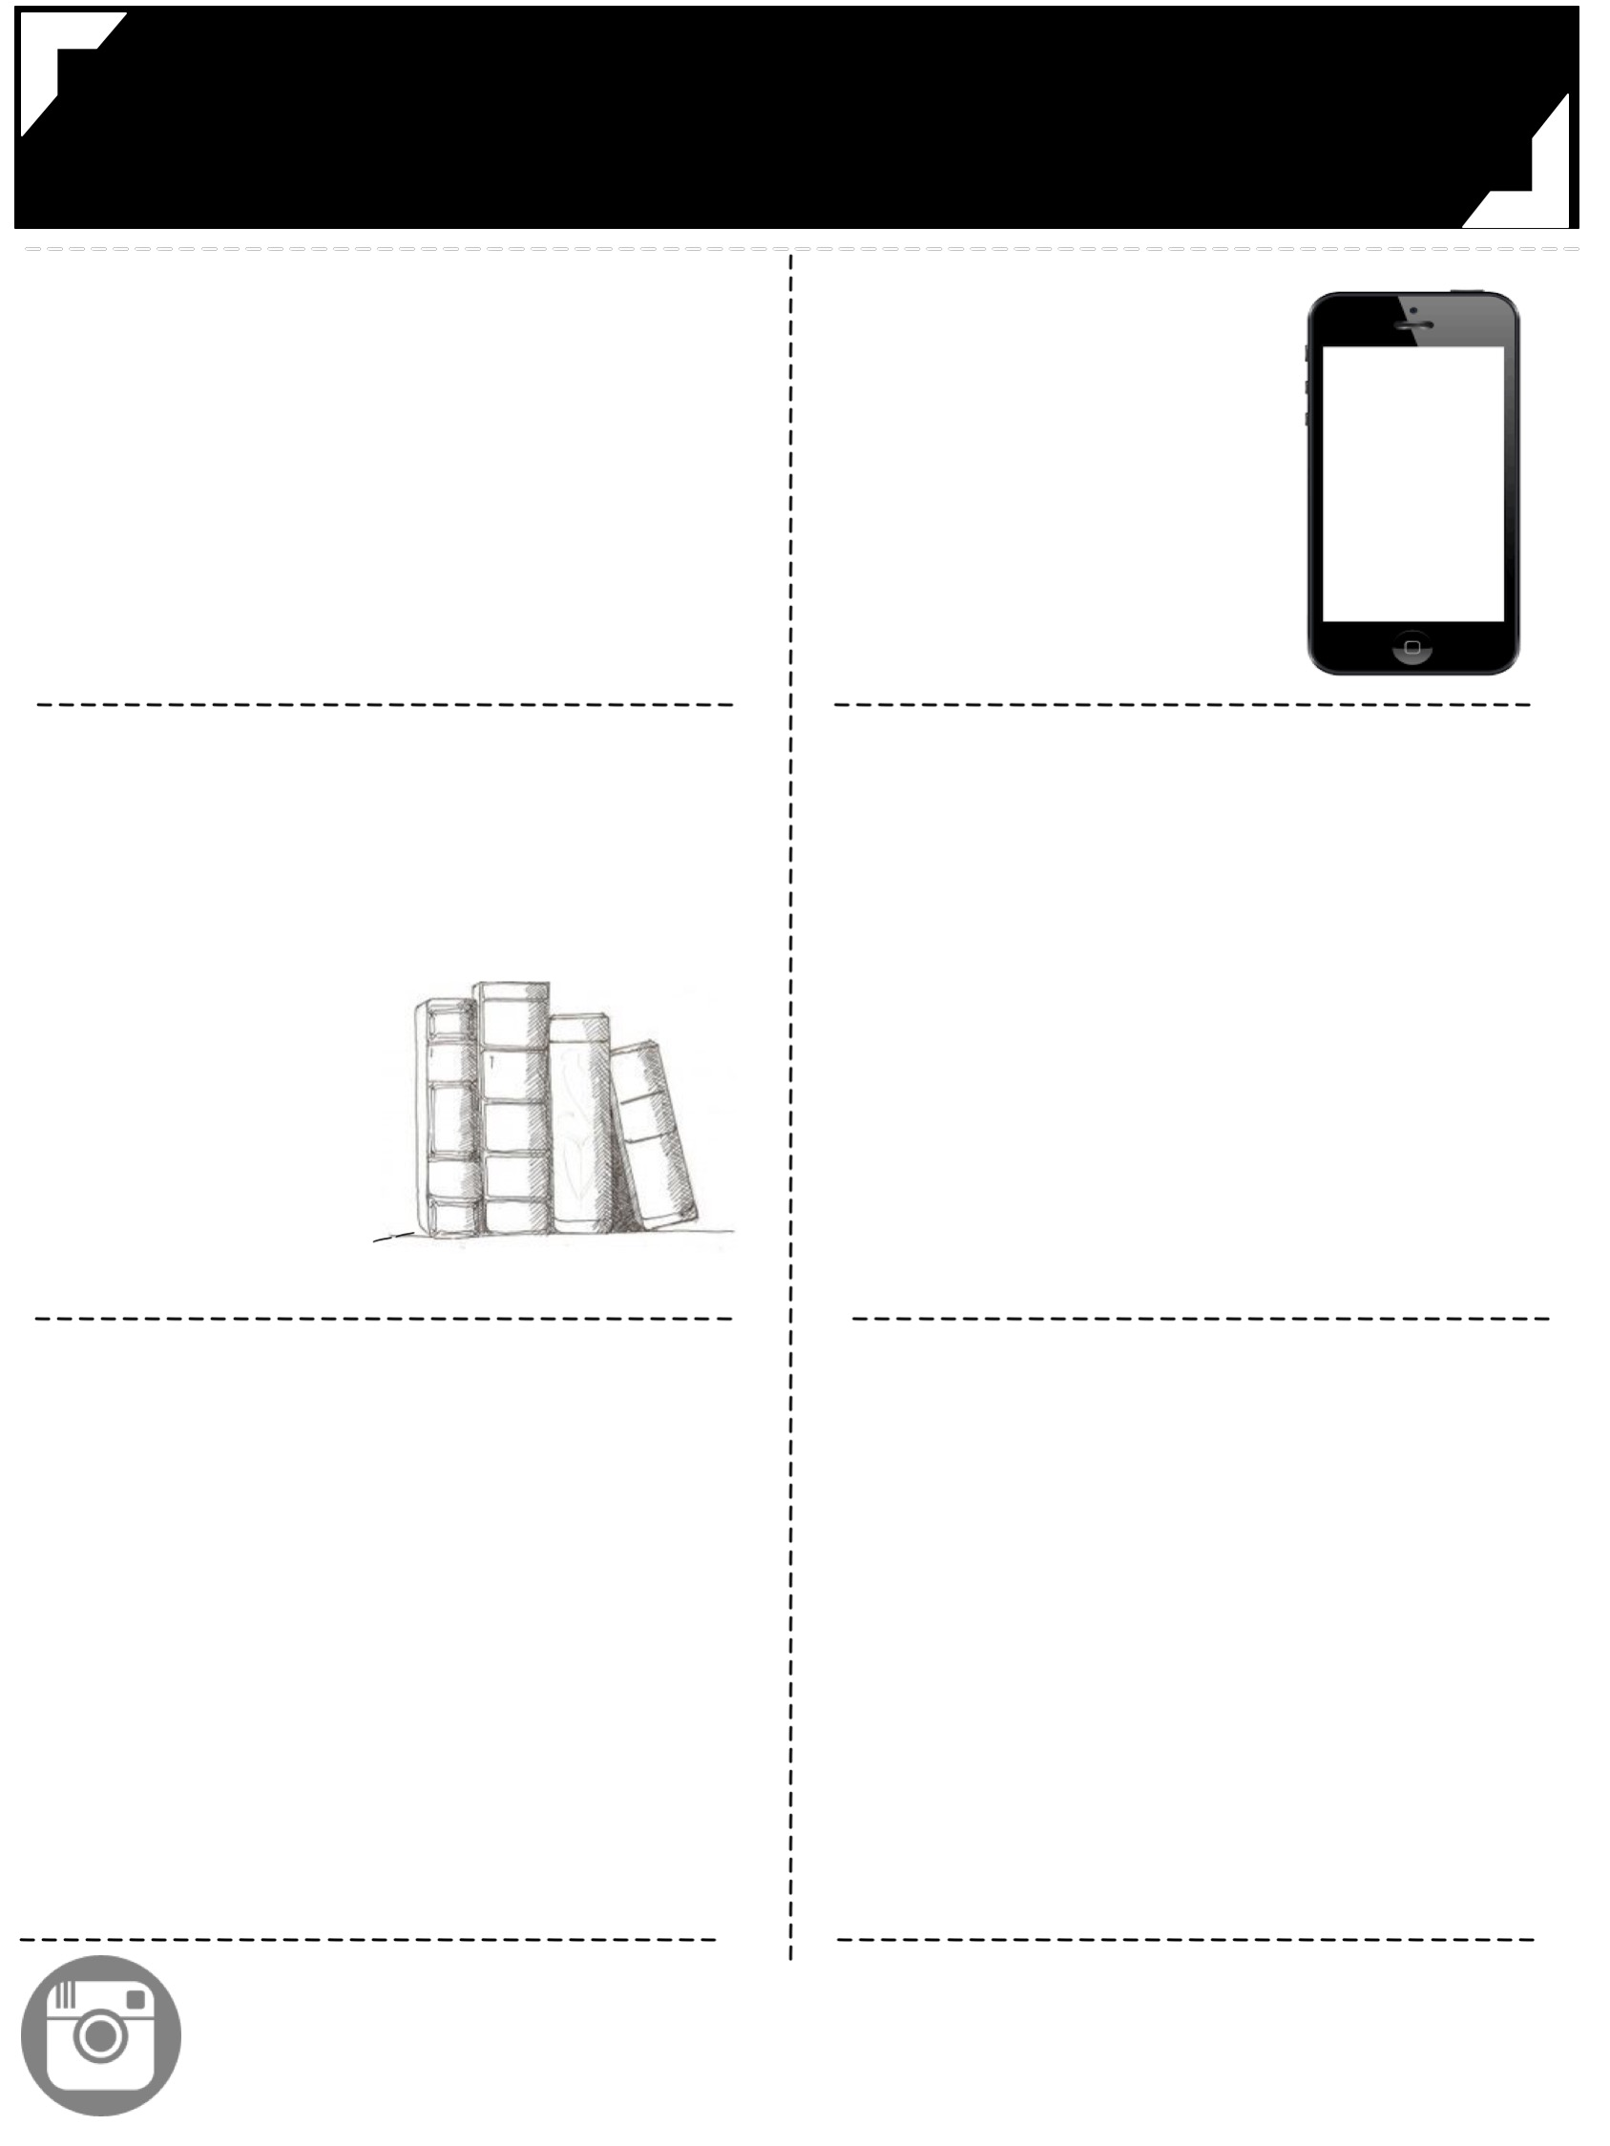
Middle School English
Mrs. Cahill
2016 -------
------- 2017
-----------------------------------------------------------------------
-----------------------------------------------------------------------
communication
with the teacher
1 mcahill@school.org
2 Remind101 app chat
3 (719) 555-5555
Text Message Alerts
eighth
grade
seventh
grade
Text @teacher
to 5555
Text @teacher
to 5555
---------------------------------
---------------------------------
---------------------------------
---------------------------------
class materials
preparation
1
2
3
Come prepared to class with your binder, planner, notebooks, writing utensils, & interactive notebook supplies.
Start working on bell ringers immediately so class can start within five minutes of the bell. This is when I will grade your bell ringers.
Work should be turned in on its due date. Late work
will lose points on a per-day-late basis.
2 composition notebooks
______
Pencils & pens
___________
colored pencils,
scissors, glue
________
sticky notes, highlighters
__
grades
responsibility
30%
20%
20%
20%
10%
Weekly and daily work will be updated weekly (bell ringers, participation, and quizzes). Please check grades regularly and feel free to ask me any questions that you might have about a particular grade.
If you are absent, you are responsible for completing your make-up work (one day for make-up for each day absent).
This can be done before or after school or via e-mail.
Papers
Projects
Reading Response
Bell ringers/daily Work
Tests & Quizzes
Participation
---------------------------------
---------------------------------
---------------------------------
---------------------------------
instagram
@mrscahillsclass
@mrscahillsbooks
Follow our class account
to see yourself and classmates in action.
Follow my book instagram for book recommendations.

Slide 19
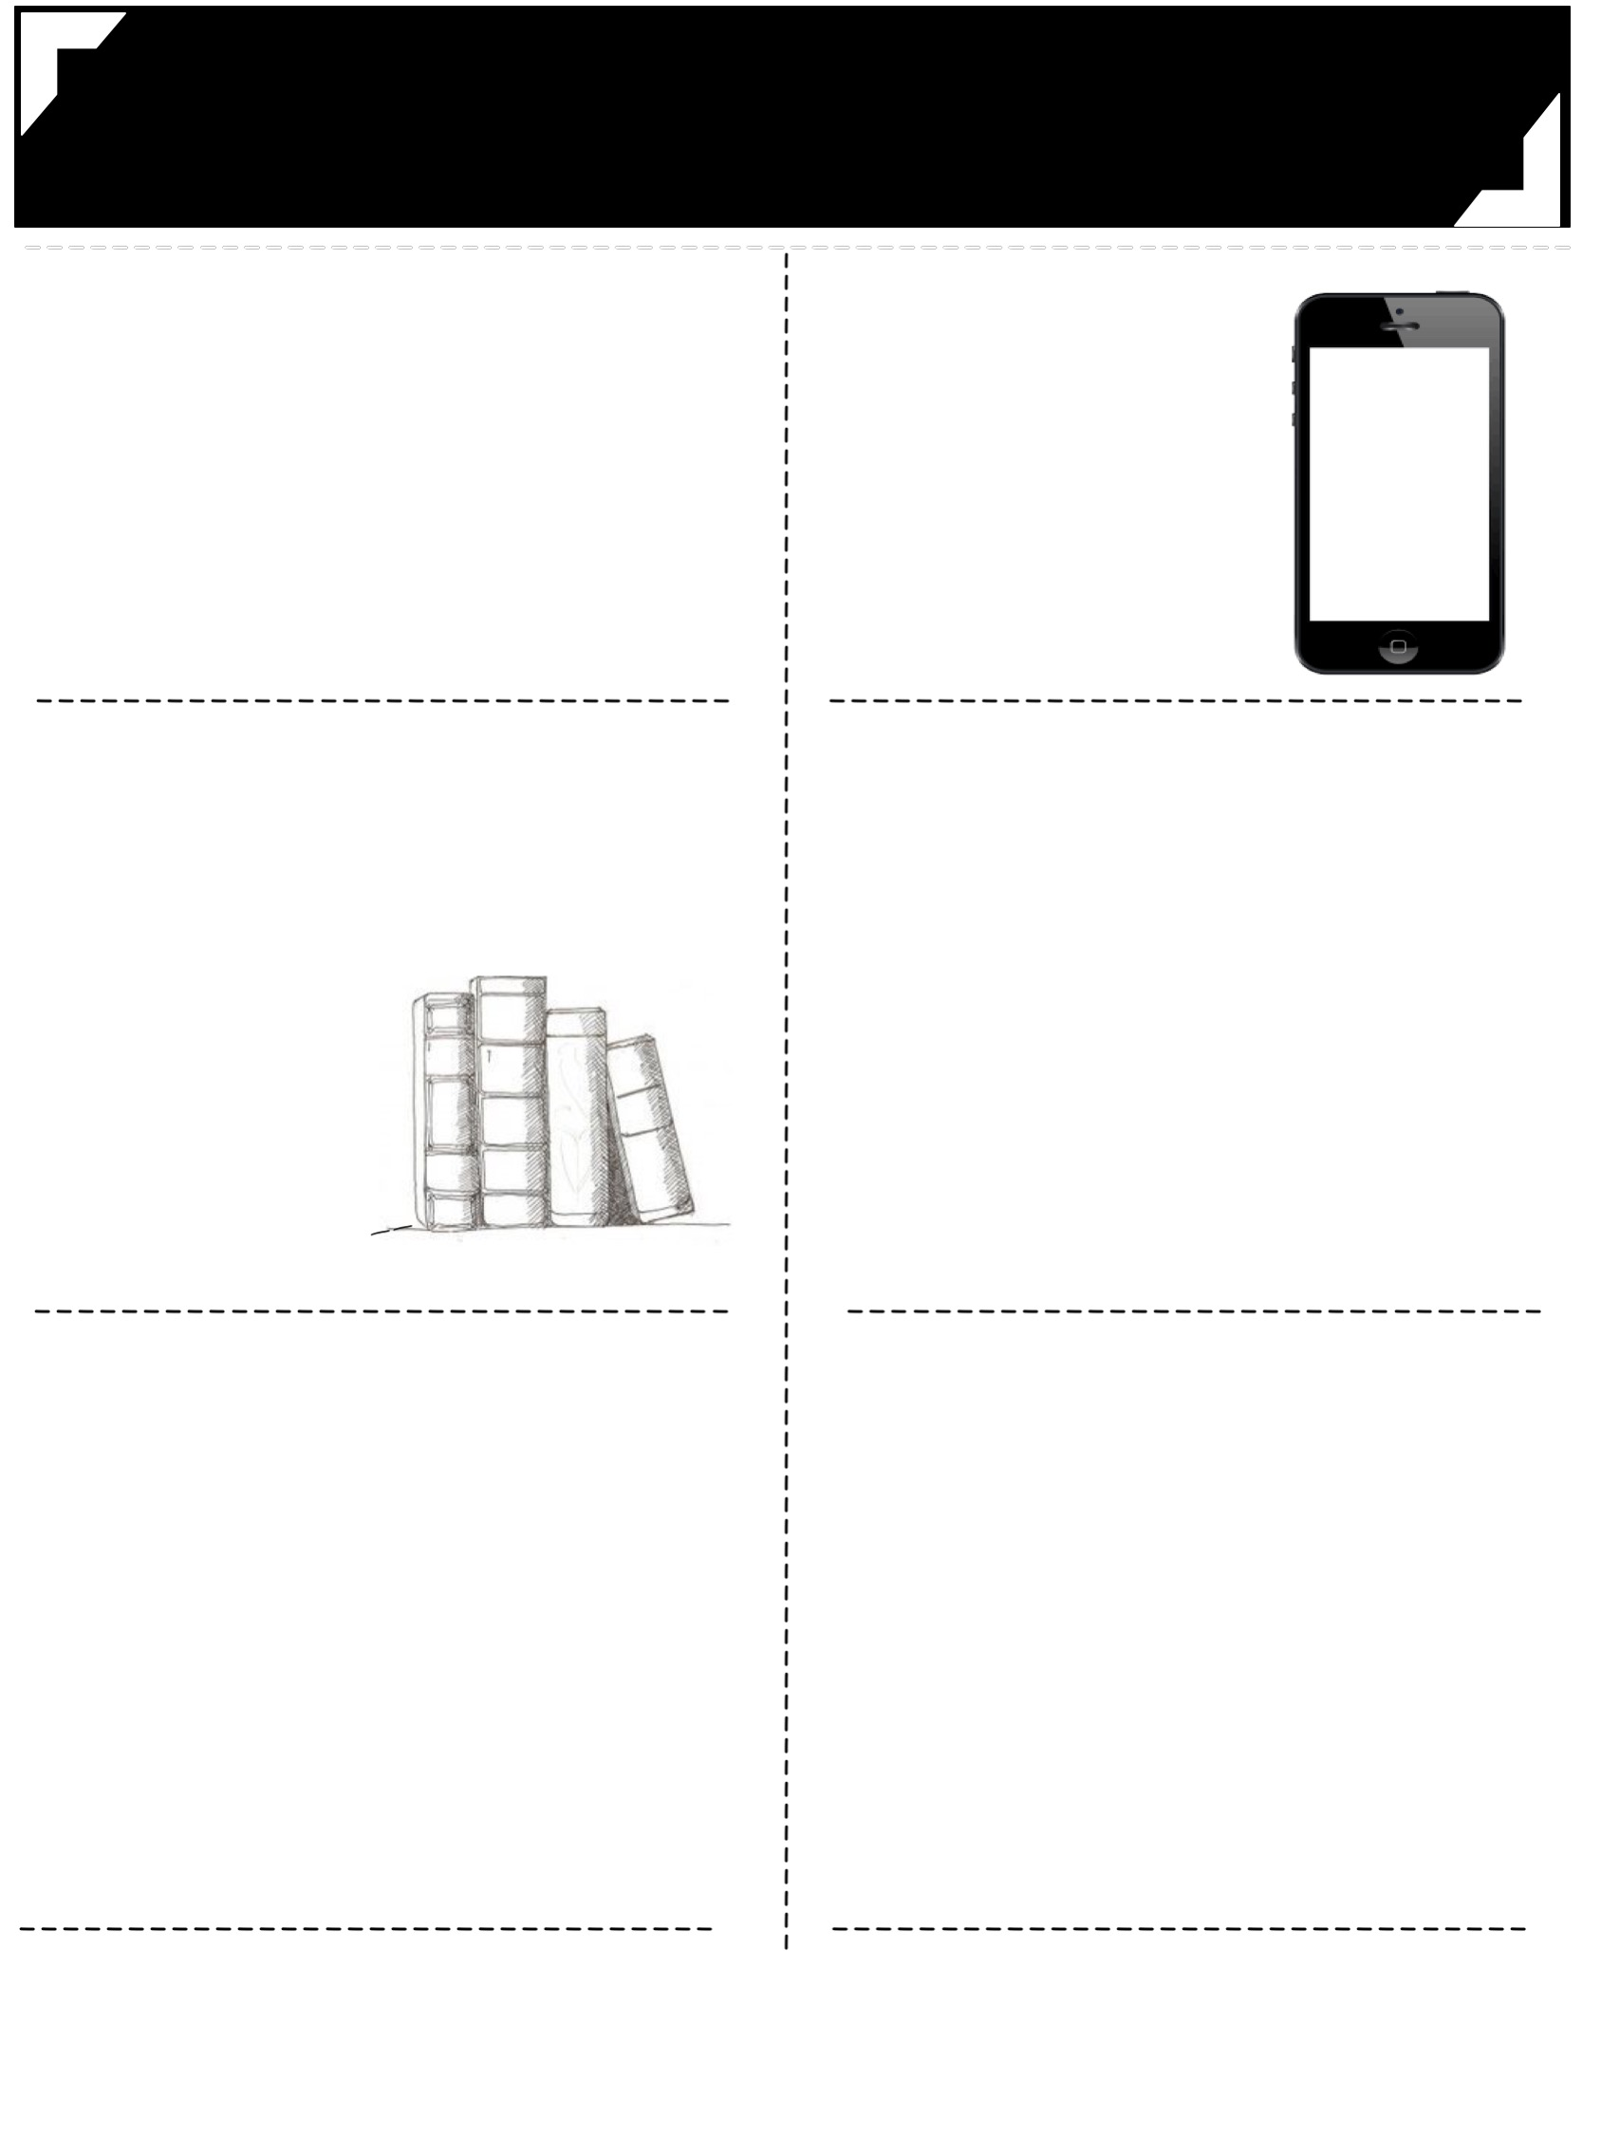
Middle School English
Mrs. Cahill
2016 -------
------- 2017
-----------------------------------------------------------------------
-----------------------------------------------------------------------
communication
with the teacher
1 mcahill@school.org
2 Remind101 app chat
3 (719) 555-5555
Text Message Alerts
eighth
grade
seventh
grade
Text @teacher
to 5555
Text @teacher
to 5555
---------------------------------
---------------------------------
---------------------------------
---------------------------------
class materials
preparation
1
2
3
Come prepared to class with your binder, planner, notebooks, writing utensils, & interactive notebook supplies.
Start working on bell ringers immediately so class can start within five minutes of the bell. This is when I will grade your bell ringers.
Work should be turned in on its due date. Late work
will lose points on a per-day-late basis.
2 composition notebooks
______
Pencils & pens
___________
colored pencils,
scissors, glue
________
sticky notes, highlighters
__
grades
responsibility
30%
20%
20%
20%
10%
Weekly and daily work will be updated weekly (bell ringers, participation, and quizzes). Please check grades regularly and feel free to ask me any questions that you might have about a particular grade.
If you are absent, you are responsible for completing your make-up work (one day for make-up for each day absent).
This can be done before or after school or via e-mail.
Papers
Projects
Reading Response
Bell ringers/daily Work
Tests & Quizzes
Participation
---------------------------------
---------------------------------
---------------------------------
---------------------------------
instagram
@mrscahillsclass
@mrscahillsbooks
Follow our class account
to see yourself and classmates in action.
Follow my book instagram for book recommendations.

Slide 20
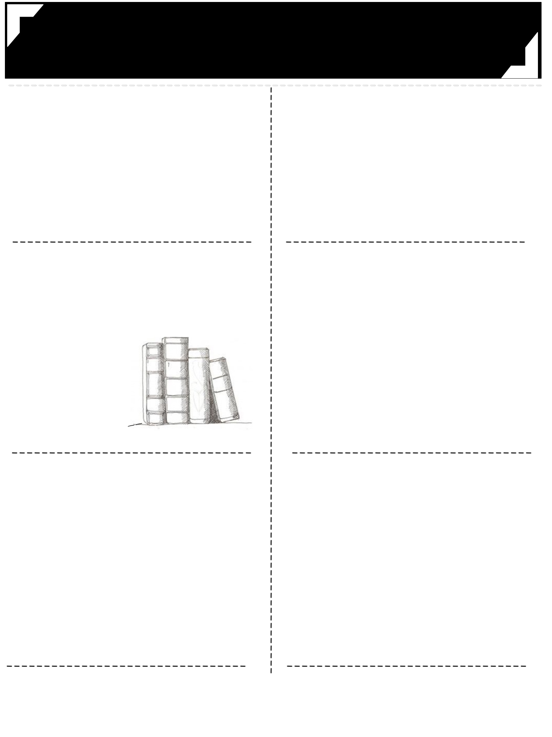
Middle School English
Mrs. Cahill
2016 -------
------- 2017
-----------------------------------------------------------------------
-----------------------------------------------------------------------
communication
with the teacher
1 mcahill@school.org
2 Remind101 app chat
3 (719) 555-5555
Text Message Alerts
eighth
grade
seventh
grade
Text @teacher
to 5555
Text @teacher
to 5555
---------------------------------
---------------------------------
---------------------------------
---------------------------------
class materials
preparation
1
2
3
Come prepared to class with your binder, planner, notebooks, writing utensils, & interactive notebook supplies.
Start working on bell ringers immediately so class can start within five minutes of the bell. This is when I will grade your bell ringers.
Work should be turned in on its due date. Late work
will lose points on a per-day-late basis.
2 composition notebooks
______
Pencils & pens
___________
colored pencils,
scissors, glue
________
sticky notes, highlighters
__
grades
responsibility
30%
20%
20%
20%
10%
Weekly and daily work will be updated weekly (bell ringers, participation, and quizzes). Please check grades regularly and feel free to ask me any questions that you might have about a particular grade.
If you are absent, you are responsible for completing your make-up work (one day for make-up for each day absent).
This can be done before or after school or via e-mail.
Papers
Projects
Reading Response
Bell ringers/daily Work
Tests & Quizzes
Participation
---------------------------------
---------------------------------
---------------------------------
---------------------------------
instagram
@mrscahillsclass
@mrscahillsbooks
Follow our class account
to see yourself and classmates in action.
Follow my book instagram for book recommendations.

Slide 21
Middle School English
Mrs. Cahill
2016 -------
------- 2017
-----------------------------------------------------------------------
communication
with the teacher
1 mcahill@school.org
2 Remind101 app chat
3 (719) 555-5555
seventh
grade
eighth
grade
TEXT
MESSAGE ALERTS
Text @teacher
to 5555
Text @teacher
to 5555
--------------------------------
--------------------------------
pteparation
class materials
1
2
3
Come prepared to class with your binder, planner, notebooks, writing utensils, & interactive notebook supplies.
Start working on bell ringers immediately so class can start within five minutes of the bell. This is when I will grade your bell ringers.
Work should be turned in on its due date. Late work
will lose points on a per-day-late basis.
2 composition notebooks
______
Pencils & pens
___________
colored pencils,
scissors, glue
________
__
______
sticky notes, highlighters
--------------------------------
--------------------------------
grades
responsibility
30%
20%
20%
20%
10%
Weekly and daily work will be updated weekly (bell ringers, participation, and quizzes). Please check grades regularly and feel free to ask me any questions that you might have about a particular grade.
Papers
Projects
Reading Response
Tests & Quizzes
Bell ringers/
daily Work
Participation
If you are absent, you are responsible for completing your make-up work (one day for make-up for each day absent). This can be done before or after school or via e-mail.
-----------------------------------------------------------------------
instagram
@mrscahillsclass
@mrscahillsbooks
Follow our class account
to see yourself and classmates in action.
Follow my book instagram for book recommendations.

Slide 22
Middle School English
Mrs. Cahill
2016 -------
------- 2017
-----------------------------------------------------------------------
communication
with the teacher
1 mcahill@school.org
2 Remind101 app chat
3 (719) 555-5555
seventh
grade
eighth
grade
TEXT
MESSAGE ALERTS
Text @teacher
to 5555
Text @teacher
to 5555
--------------------------------
--------------------------------
pteparation
class materials
1
2
3
Come prepared to class with your binder, planner, notebooks, writing utensils, & interactive notebook supplies.
Start working on bell ringers immediately so class can start within five minutes of the bell. This is when I will grade your bell ringers.
Work should be turned in on its due date. Late work
will lose points on a per-day-late basis.
2 composition notebooks
______
Pencils & pens
___________
colored pencils,
scissors, glue
________
__
______
sticky notes, highlighters
--------------------------------
--------------------------------
grades
responsibility
30%
20%
20%
20%
10%
Weekly and daily work will be updated weekly (bell ringers, participation, and quizzes). Please check grades regularly and feel free to ask me any questions that you might have about a particular grade.
Papers
Projects
Reading Response
Tests & Quizzes
Bell ringers/
daily Work
Participation
If you are absent, you are responsible for completing your make-up work (one day for make-up for each day absent). This can be done before or after school or via e-mail.
-----------------------------------------------------------------------
instagram
@mrscahillsclass
@mrscahillsbooks
Follow our class account
to see yourself and classmates in action.
Follow my book instagram for book recommendations.

Slide 23
second page templates
These last 4 pages can be used for the second page of your syllabus.
(These were added as part of an update!)

Slide 24
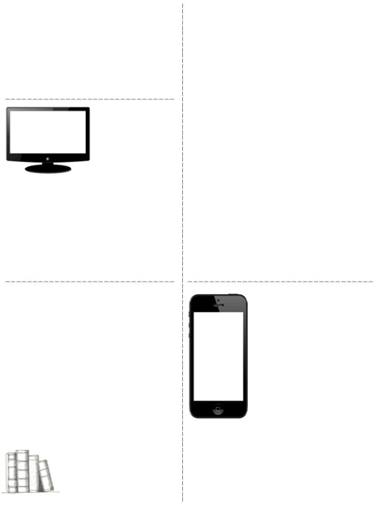
food and drink policy
policy for absences & grades
In general, food and drinks are allowed in my class. This is contingent on it not becoming a distraction in class, and as long as students can handle the responsibility. This policy is subject to change at my discretion, and at any time.
Weekly and daily work will be updated weekly (bell ringers, participation, and quizzes). Please check grades regularly and feel free to ask me any questions that you might have about a particular grade.
If you are absent, you are responsible for completing your make-up work (one day for make-up for each day absent).
All make-up work will be placed in your classes absent folder and your name will be written on any work you missed. It is your responsibility to ask a classmate or me for help on making up any interactive notebook assignments (you can always borrow my notebook), and/or to meet with Mrs. Cahill to make up any tests, quizzes or papers.
If you know you are going to be absent beforehand, you should ask me for your make-up work before the absence.
This can be done before or after school or via e-mail.
assignment formatting
All typed assignments must be in 12 PT TIMES NEW ROMAN FONT, double-spaced, and have 1” margins with your name, class period, and date in the top left corner with a centered title.
Mrs. Cahill has two computers in her classroom for students to use to type and research.
homework
electronic devices
Students should read 20-30 minutes every night. No reading logs will be collected, but Mrs. Cahill will collect information at the beginning of the year to meet the interests and needs of individual students’ reading lives.
Most work will be able to be completed in class if students use their time wisely. The exception to this would be typed essays. Some work may need to be done outside of classes to finish writing and/or typing final paper.
Electronic devices should be kept in students backpacks. Devices should not be out during class, unless otherwise instructed by the teacher or with permission.
First offense: Student will turn the phone into the teacher until the end of class.
Second offense: Student will turn the phone into the teacher until the end of day.
Third offense: Phone will be turned into office and parents will have to pick up the device from the office.
If students do not complete work during class, in the time allotted, it will be assigned as homework so students can adhere to the determined deadlines.

Slide 25
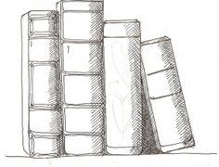
food and drink policy
policy for absences & grades
In general, food and drinks are allowed in my class. This is contingent on it not becoming a distraction in class, and as long as students can handle the responsibility. This policy is subject to change at my discretion, and at any time.
Weekly and daily work will be updated weekly (bell ringers, participation, and quizzes). Please check grades regularly and feel free to ask me any questions that you might have about a particular grade.
If you are absent, you are responsible for completing your make-up work (one day for make-up for each day absent).
All make-up work will be placed in your classes absent folder and your name will be written on any work you missed. It is your responsibility to ask a classmate or me for help on making up any interactive notebook assignments (you can always borrow my notebook), and/or to meet with Mrs. Cahill to make up any tests, quizzes or papers.
If you know you are going to be absent beforehand, you should ask me for your make-up work before the absence.
This can be done before or after school or via e-mail.
_______________________________
assignment formatting
All typed assignments must be in 12 PT TIMES NEW ROMAN FONT, double-spaced, and have 1” margins with your name, class period, and date in the top left corner with a centered title.
Mrs. Cahill has two computers in her classroom for students to use to type and research.
___________________________________________________________________________________________
_______________________________
__________________________________
homework
electronic devices
Students should read 20-30 minutes every night. No reading logs will be collected, but Mrs. Cahill will collect information at the beginning of the year to meet the interests and needs of individual students’ reading lives.
Most work will be able to be completed in class if students use their time wisely. The exception to this would be typed essays. Some work may need to be done outside of classes to finish writing and/or typing final paper.
Electronic devices should be kept in students backpacks. Devices should not be out during class, unless otherwise instructed by the teacher or with permission.
First offense: Student will turn the phone into the teacher until the end of class.
Second offense: Student will turn the phone into the teacher until the end of day.
Third offense: Phone will be turned into office and parents will have to pick up the device from the office.
If students do not complete work during class, in the time allotted, it will be assigned as homework so students can adhere to the determined deadlines.

Slide 26
food and drink policy
policy for absences & grades
In general, food and drinks are allowed in my class. This is contingent on it not becoming a distraction in class, and as long as students can handle the responsibility. This policy is subject to change at my discretion, and at any time.
Weekly and daily work will be updated weekly (bell ringers, participation, and quizzes). Please check grades regularly and feel free to ask me any questions that you might have about a particular grade.
If you are absent, you are responsible for completing your make-up work (one day for make-up for each day absent).
All make-up work will be placed in your classes absent folder and your name will be written on any work you missed. It is your responsibility to ask a classmate or me for help on making up any interactive notebook assignments (you can always borrow my notebook), and/or to meet with Mrs. Cahill to make up any tests, quizzes or papers.
If you know you are going to be absent beforehand, you should ask me for your make-up work before the absence.
This can be done before or after school or via e-mail.
assignment formatting
All typed assignments must be in 12 PT TIMES NEW ROMAN FONT, double-spaced, and have 1” margins with your name, class period, and date in the top left corner with a centered title.
Mrs. Cahill has two computers in her classroom for students to use to type and research.
_______________________________
homework
electronic devices
Students should read 20-30 minutes every night. No reading logs will be collected, but Mrs. Cahill will collect information at the beginning of the year to meet the interests and needs of individual students’ reading lives.
Most work will be able to be completed in class if students use their time wisely. The exception to this would be typed essays. Some work may need to be done outside of classes to finish writing and/or typing final paper.
Electronic devices should be kept in students backpacks. Devices should not be out during class, unless otherwise instructed by the teacher or with permission.
First offense: Student will turn the phone into the teacher until the end of class.
Second offense: Student will turn the phone in to teacher until the end of day.
Third offense: Phone will be turned into office and parents will have to pick up the device from the office.
If students do not complete work during class, in the time allotted, it will be assigned as homework so students can adhere to the determined deadlines.

Slide 27
food and drink policy
policy for absences & grades
In general, food and drinks are allowed in my class. This is contingent on it not becoming a distraction in class, and as long as students can handle the responsibility. This policy is subject to change at my discretion, and at any time.
Weekly and daily work will be updated weekly (bell ringers, participation, and quizzes). Please check grades regularly and feel free to ask me any questions that you might have about a particular grade.
If you are absent, you are responsible for completing your make-up work (one day for make-up for each day absent).
All make-up work will be placed in your classes absent folder and your name will be written on any work you missed. It is your responsibility to ask a classmate or me for help on making up any interactive notebook assignments (you can always borrow my notebook), and/or to meet with Mrs. Cahill to make up any tests, quizzes or papers.
If you know you are going to be absent beforehand, you should ask me for your make-up work before the absence.
This can be done before or after school or via e-mail.
assignment formatting
All typed assignments must be in 12 PT TIMES NEW ROMAN FONT, double-spaced, and have 1” margins with your name, class period, and date in the top left corner with a centered title.
Mrs. Cahill has two computers in her classroom for students to use to type and research.
_______________________________
homework
electronic devices
Students should read 20-30 minutes every night. No reading logs will be collected, but Mrs. Cahill will collect information at the beginning of the year to meet the interests and needs of individual students’ reading lives.
Most work will be able to be completed in class if students use their time wisely. The exception to this would be typed essays. Some work may need to be done outside of classes to finish writing and/or typing final paper.
Electronic devices should be kept in students backpacks. Devices should not be out during class, unless otherwise instructed by the teacher or with permission.
First offense: Student will turn the phone into the teacher until the end of class.
Second offense: Student will turn the phone in to teacher until the end of day.
Third offense: Phone will be turned into office and parents will have to pick up the device from the office.
If students do not complete work during class, in the time allotted, it will be assigned as homework so students can adhere to the determined deadlines.

