Slide 1
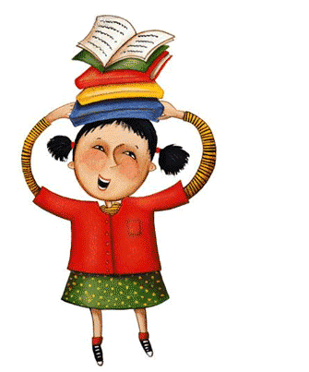

Elements of a
Story
Stanaway

Slide 2
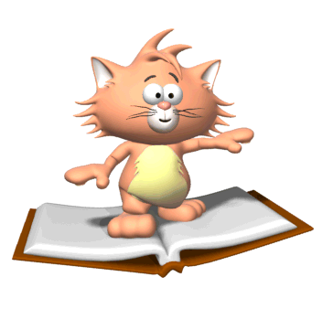
Elements of a Story:
Setting – The time and place a story takes place.
Characters – the people, animals or creatures in a story.
Plot – the series of events that make up a story.
Conflict – a problem or struggle between two people, things or ideas.

Slide 3
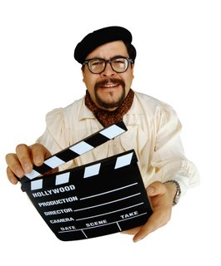
Setting

Slide 4
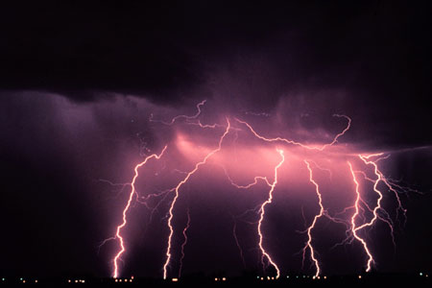
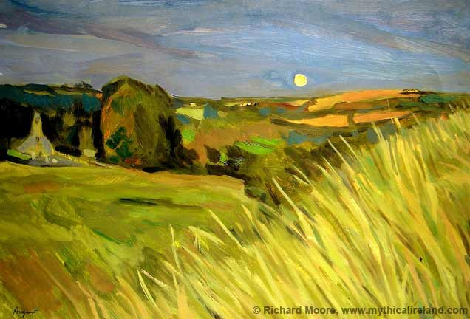
Setting
The setting describes where an when the story takes place.
It helps build background and create images in the mind.
It helps set the tone or mood of the story.
Details can describe:
  Time of day
  Time of year
  Time in History
  Scenery
  Weather
  Location

Slide 5
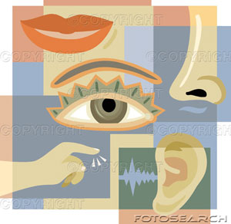
Using the Five Senses
A good setting helps the reader visualize the places in the story.
A good author includes descriptions of the setting using the five senses…
SIGHT
SMELL
TASTE
FEEL
SOUND

Slide 6
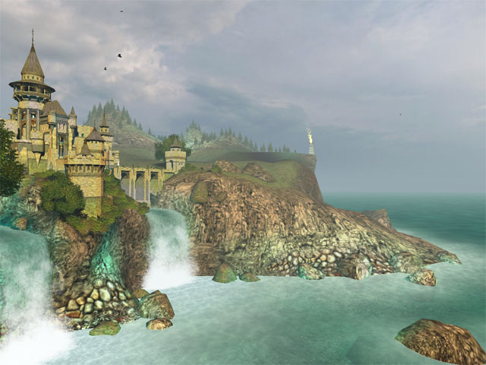
Take a Look…Which is better?
The castle was beside the water.
OR…
The waves crashed loudly against the shoreline. The fog lifted lightly and the medieval castle came into view. It was a beautiful site! The fog brushed my face and I could smell the smoke from the fire in the distance and taste the sea salt on my lips.

Slide 7

Your Turn…
On the next slide, there is a picture of a setting.
In your own words, write a detailed description of the setting in your picture. Include many adjectives and don’t forget to include descriptions for each of the five senses: see, hear, feel, smell, taste

Slide 8
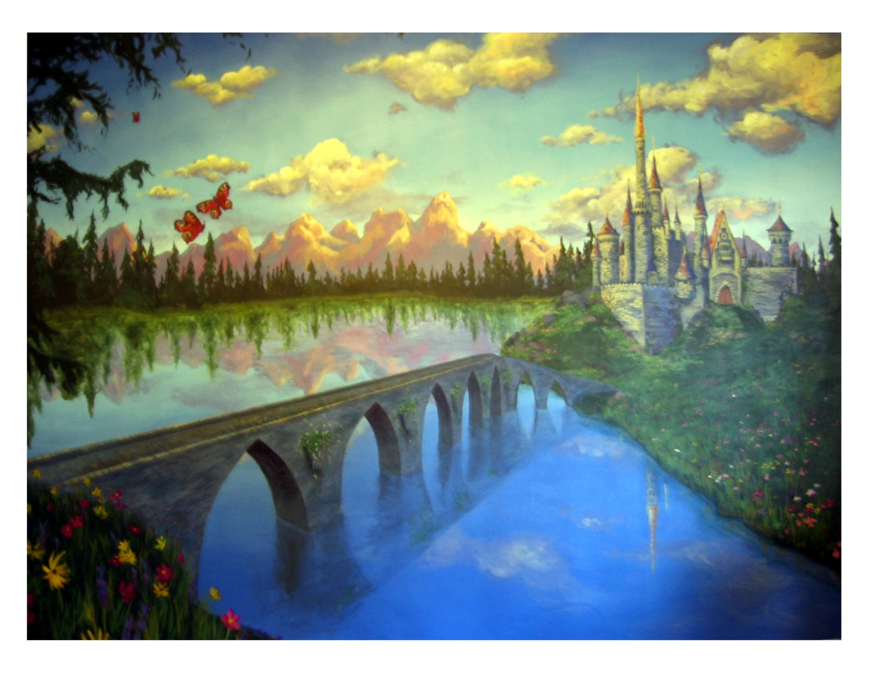

Slide 9
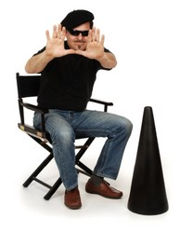
Characters

Slide 10

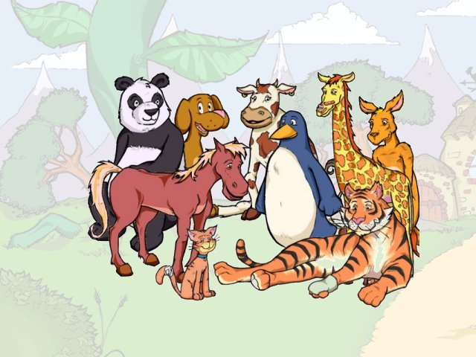
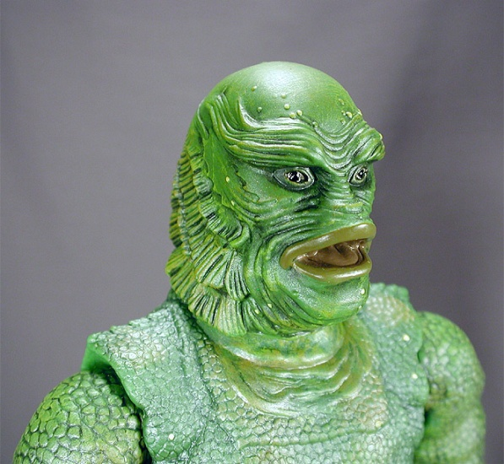
Every story needs Characters…
People
Animals
Or Creatures

Slide 11
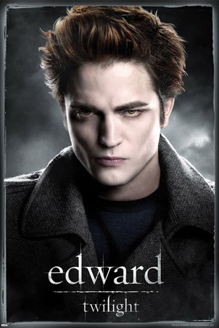
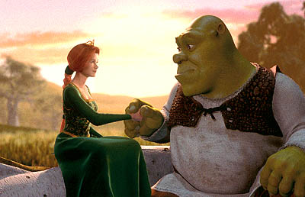
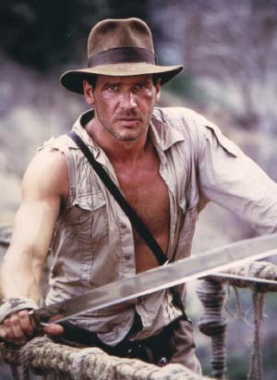
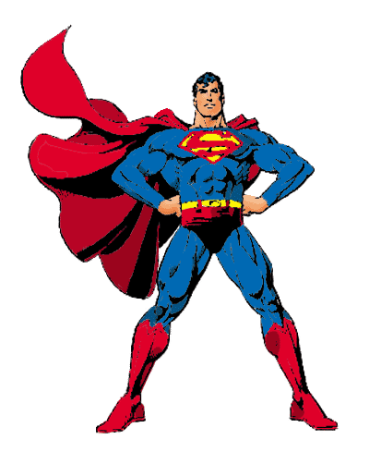
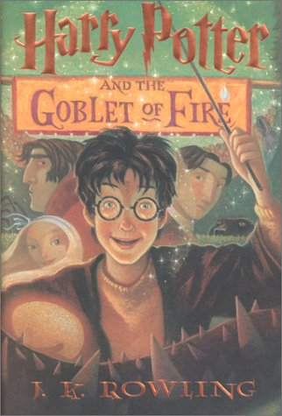
The protagonist is the leading character. Usually the “good guy”

Slide 12
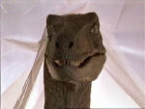
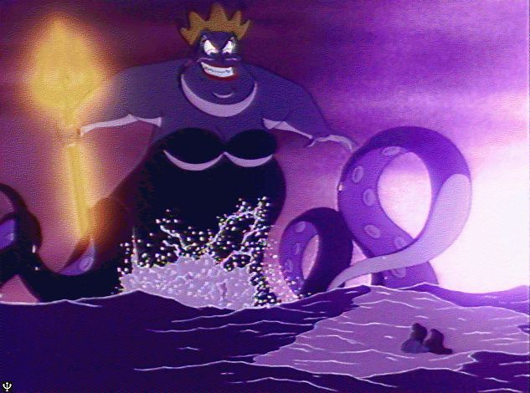

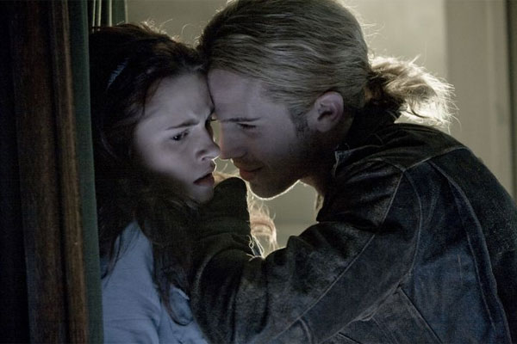
The antagonist is the opposing force. Usually the “bad guy”.

Slide 13
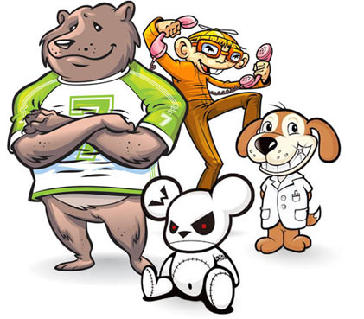
Characterization
Characterization is the way in which an author shows the personality of a character
Characterization is a technique writers use to make characters “come to life.”

Slide 14
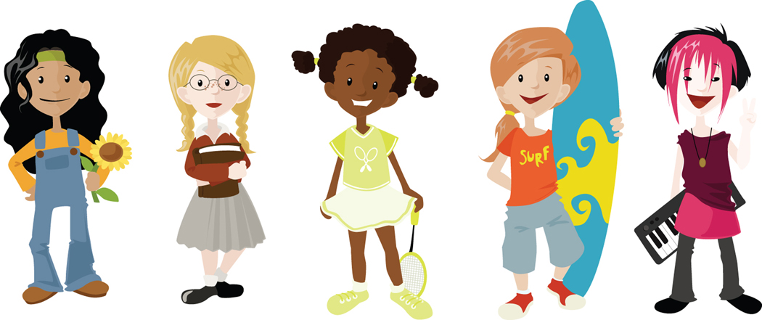
Think about your favorite book, movie or TV character…
How can you describe his/her appearance?
What kind of personality does he/she have?
What kinds of things does he/she like?
Make a list of character traits for this character.

Slide 15
Characterization
Characters are people or animals in a story.
A writer can tell you directly about a character… (Freddy was very competitive)
Or
A writer can tell you indirectly about a character… (Two days before the game, Freddy gathered his teammates and laid out his plan. Then he looked at them and said, “We are going to win this one. No excuses.”)

Slide 16
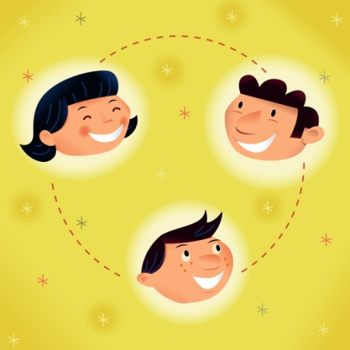
Direct Characterization
Direct Characterization tells the reader the personality of the character.
Direct Characterization is obvious to the reader and “spells” it right out.
“The patient boy and the quiet girl were both well behaved and did not disobey their mother.

Slide 17
Indirect Characterization
Indirect Characterization shows things that reveal the personality of the character.
Speech
Thought
Effect on Others
Actions
Looks
The boy sat next to his sister as she poked him and teased him. He did not react. He carefully picked up her doll from the floor and placed it on her lap saying gently, “Here you go, why don’t you play with your doll?”

Slide 18
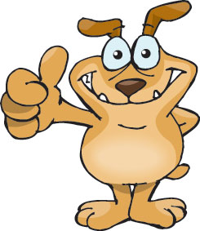
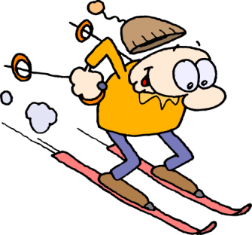

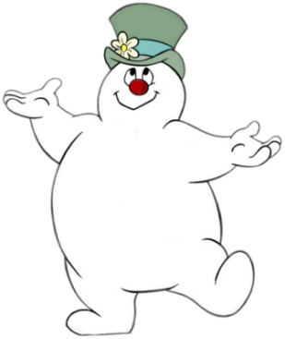
Indirect Characterization…
☻What does the character say? How does the character speak?
☻ What is revealed through the character’s private thoughts and feelings?
☻ What is the character’s effect on others? How do other characters feel or behave in reaction to the character?
☻ What does the character do? How does he/she behave?
☻ What does the character look like? Dress like?

Slide 19
Character Traits
Character Traits are descriptive adjectives that tell us specific qualities of a character
Honest Light-hearted Leader Expert Brave Conceited Mischievous Demanding Thoughtful Keen Happy Disagreeable Simple Fancy Plain | Excited Studious Inventive Creative Thrilling Independent Intelligent Compassionate Gentle Proud Wild Messy Neat Joyful Strong | Bright Courageous Serious Funny Humorous Sad Poor Rich Tall Dark Light Handsome Pretty Ugly Selfish | Unselfish Self-confident Respectful Considerate Imaginative Busy Patriotic Fun-loving Popular Successful Responsible Lazy Dreamer Helpful Simple-minded | Humble Friendly Short Adventurous Hard-working Timid Shy Bold Daring Dainty Pitiful Cooperative Lovable Prim Proper | Ambitious Able Quiet Curious Reserved Pleasing Bossy Witty Fighter Tireless Energetic Cheerful Smart Impulsive Loyal

Slide 20

Factors in Analyzing Characters
Physical appearance/what they look like
Personality & Character Traits
Background/personal history
Motivation/why do they act?
Relationships
Conflict or struggles
Does the character change?
What do they think and feel?
How do others feel about them?

Slide 21

Character Motivation
Character Motivation is the driving force behind why the character does what he/she does. (Reasons for character’s actions)
What does the main character want more than anything else (main goal)?
What do secondary characters want more than anything else (main goal)?
What potential conflicts or struggles might exist between the characters?

Slide 22
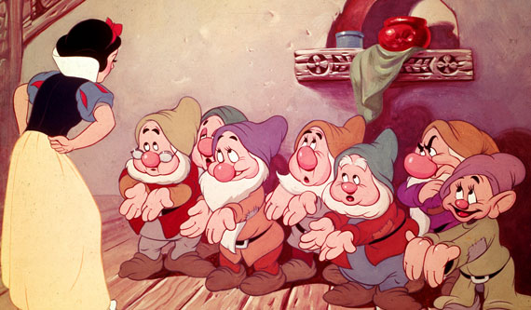
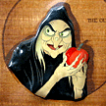
Snow White: Character Motivation
Character Motivation. Why does the queen’s heart turn against Snow White?
Character Motivation. Why do the dwarfs allow Snow White to stay with them?
Character Motivation. Why does the queen disguise herself as an old peddler woman?
Character Motivation. Why does the queen give Snow White the poison apple?

Slide 23


Your Turn…Think of a character from a book, a movie or TV…
Who is the character? From what story?
What does he/she want?
What does he/she need?
What is his/her motivation?
What does he/she do to get what they need?
How does the character change during the movie, book or TV show?

Slide 24
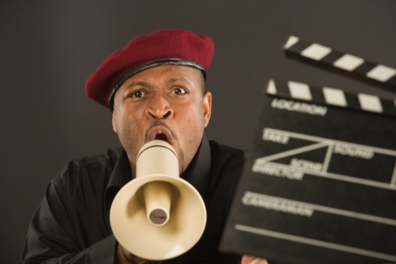
Plot

Slide 25
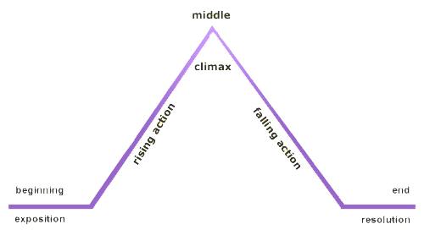
Plot
Plot - the events that take place in a story. Every story needs a plot! The plot has different “parts…”

Slide 26

Plot Components
Climax: the turning point, the most intense moment—either mentally or in action
Rising Action: the series of events and conflicts in the story that lead to the climax
Falling Action: all of the action which follows the climax
Exposition: the start of the story, before the action starts
Resolution: the conclusion, the tying together of all of the threads
Notes:
Exposition: The mood and conditions existing at the beginning of the story. The setting is identified. The main characters with their positions, circumstances and relationships to one another are established. The exciting force or initial conflict is introduced. Sometimes called the “Narrative HOOK” this begins the conflict that continues throughout the story.
Rising Action: The series of events, conflicts, and crises in the story that lead up to the climax, providing the progressive intensity, and complicate the conflict.
Climax: The turning point of the story. A crucial event takes place and from this point forward, the protagonist moves toward his inevitable end. The event may be either an action or a mental decision that the protagonist makes.
Falling Action: The events occurring from the time of the climax to the end of the story. The main character may encounter more conflicts in this part of the story, but the end is inevitable.
Resolution/Denouement: The tying up of loose ends and all of the threads in the story. The conclusion. The hero character either emerges triumphant or is defeated at this point.

Slide 27
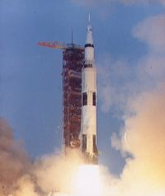
The climax is the most exciting part!!

Slide 28
Special Techniques of Plot…
Suspense- excitement or tension
Flashback- interrupts the normal sequence of events to tell about something that happened in the past
Surprise Ending- conclusion that reader does not expect
And…Foreshadowing…

Slide 29



A hint about what will happen next is called foreshadowing
For example, if you hear this:
Then you know someone’s about to get eaten!

Slide 30
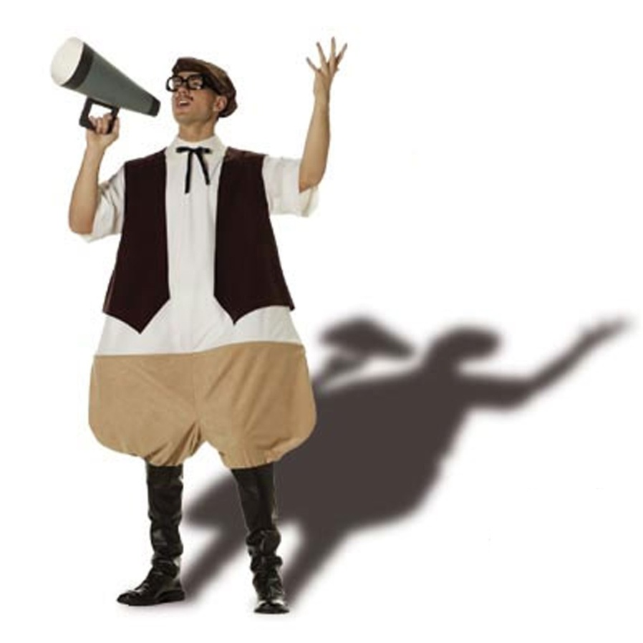
Conflict

Slide 31
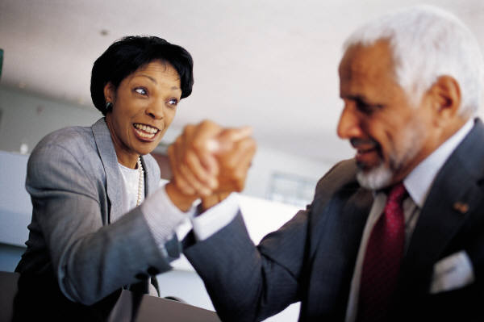
Conflict
Conflict is the “battle” between two forces.
Conflict isn’t always bad..sometimes it helps to create change.

Slide 32
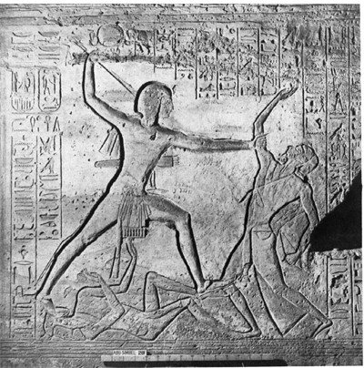
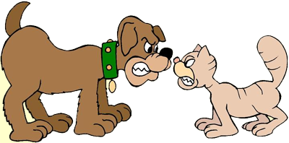
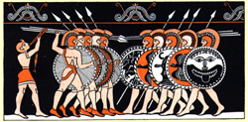
Conflict
Conflict is the struggle between two forces in a story. Without conflict, there is no plot.

Slide 33
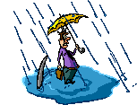

Types of Conflict
Character vs Character
Character vs Nature
Character vs Society
Character vs Self

Slide 34
Types Of Conflict…a deeper look
Character vs. Character
(problem with another character)
2. Character vs. Nature
(problem with force of nature)
3. Character vs. Society
(problem with the laws or beliefs of a group)
(character vs. community, society or culture)
4. Character vs. Self
(problem with deciding what to
do or think; “inner conflict”)

Slide 35
Your turn…
What’s a well-known movie that has…
Character vs. Character Conflict
Character vs. Nature Conflict
Character vs. Society
Character vs. Self

