Slide 1
Poetry Structure
Casey at the Bat

Slide 2
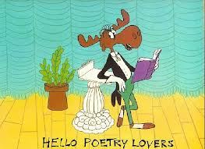
Poetry is different than Prose!
We must read it differently!

Slide 3
Strategies for Reading Poetry!
Preview! Look at the title, pictures, etc.
Read poem silently, pausing only at punctuation.
Read poem aloud listening to rhythm.
Read poem a third time and think about images. Visualize the poem in your mind!
Look at specific words and phrases—use strategies to figure out things you don’t understand! (dictionary, context clues, ask peer)
Think about a poem’s meaning or theme. What is the message?
Notes:
Pass out “Strategies for Reading Poetry - Student Handout”

Slide 4
Finding Our Way Around a Poem!
Line: a row of words in a poem
Stanza: a verse of a poem; a group of lines in a poem.
Rhyme Scheme: rhyme pattern in a poem; marked with letters—Each rhyme is assigned a letter.
Notes:
Pass Out Poetic Elements Notes

Slide 5
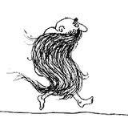
“My Beard” (Shel Silverstein)
My beard grows to my toes,
I never wear no clothes,
I wraps my hair
Around my bare,
And down the road I goes.
A
A
B
B
A
How many lines? Stanzas?
Rhyme Scheme?

Slide 6
from Rain in Summer Henry Wadsworth Longfellow
How beautiful is the rain!
After the dust and heat,
In the broad and fiery street,
In the narrow lane,
How beautiful is the rain!
How it clatters along the roofs,
Like the tramp of hoofs!
How it gushes and struggles out
From the throat of the overflowing spout!
Across the window-pane
It pours and pours;
And swift and wide,
With a muddy tide,
Like a river down the gutter roars
The rain, the welcome rain!
How many lines? Stanzas?
Rhyme Scheme?
5
10
15

Slide 7
Partner Activity “Why Nobody Pets the Lion at the Zoo”
With your partner,
Read the poem, following the “Strategies for Reading Poetry.”
Identify the number of lines.
Identify the number of stanzas.
Identify the rhyme scheme.
Notes:
Pass out Partner Practice Poem!
Poem by John Ciardi.

Slide 8
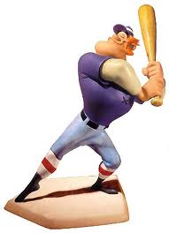
“Casey at the Bat” Ernest Lawrence Thayer
"Love has its sonnets galore. War has its epics in heroic verse. Tragedy its somber story in measured lines. Baseball has Casey at the Bat."
- Albert Spalding
Notes:
Pass Out “Poetry: Structure” and the poem “Casey at the Bat” to students.

