Slide 1
Onomatopoeia

Slide 2
Onomatopoeia
A word that imitates the sound it represents.
Bang!
Whack!
Zoom!
Moo
Notes:
Ask students to take out their Poetry Notes.

Slide 3
Onomatopoeia-The use of words whose sound makes you think of their meaning.
Buzz
Zip
Slurp
Snip
Pop
Ding
Hiss
Smack
Gulp
Crush
Drip
Creek
Sizzle
Snap

Slide 4
Examples?
What other “sound words” can you think of?

Slide 5
Mother Goose
Bow-wow, says the dog, Mew, mew says the cat, Grunt, grunt, goes the hog, And squeak goes the rat. Tu, whu, says the owl, Quack, quack, says the duck, And what the cuckoo says you know.
Bow-wow, says the dog, Mew, mew says the cat, Grunt, grunt, goes the hog, And squeak goes the rat. Tu, whu, says the owl, Quack, quack, says the duck, And what the cuckoo says you know.
What are the examples of onomatopeioa?

Slide 6
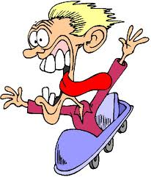
The Roller Coaster
Fasten your seatbelts,
All hands inside,
Everyone aboard for the
Roller coaster ride!
Click-clack, click-clack
Creeping up the hill,
Daredevil laughter,
Ready for the thrill.
S-L-O-W-L-Y, S-L-O-W-L-Y
Cresting to the top,
Hands start to tremble,
Hearts almost stop.
Plunge down the steep slope,
Faster than a rocket,
Loose change and sunglasses,
Fly from your pocket.
Swoop round the sharp bend,
Twisting in a loop,
Scream like a Banshee,
Yelling out a whoop!
Sail down the valleys,
Race up the hills,
Nothing else can equal
Roller coaster thrills.
Clickety-clack, clickety-clack,
Round the final bend,
Why does every roller coaster
Have…to…have…an…end?
Notes:
What words are onomatopoeia?

Slide 7
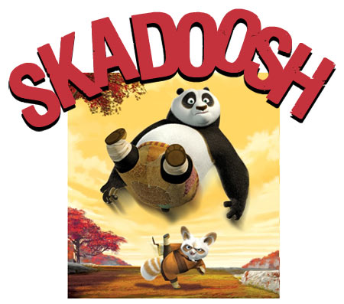

Slide 8
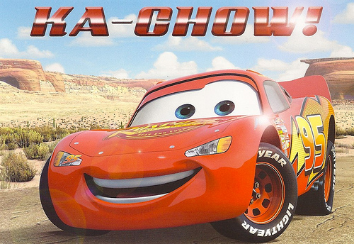

Slide 9
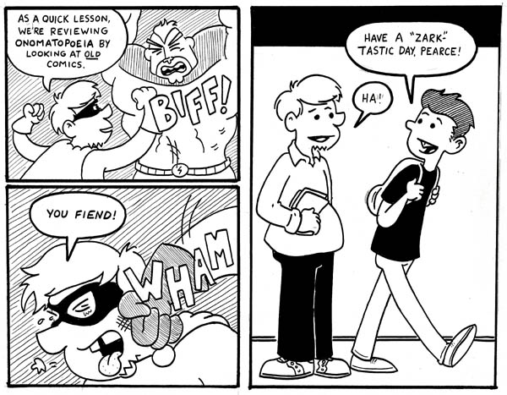
We often see onomatopoeia in comic strips!

Slide 10
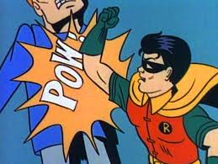
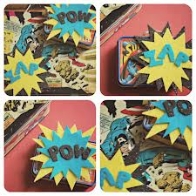

Slide 11
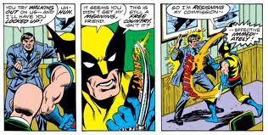

Slide 12
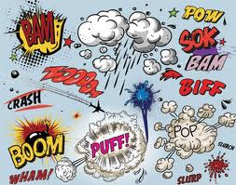
Onomatopoeia Assignment
Notes:
Pass out Assignment Sheet!

Slide 13
Create Your Own Comic Strip: 1. Use five examples of onomatopoeia. 2. Write your comic strip as a story. 3. You need at least ten frames of story. 4. Make sure it is in sequence (1st, 2nd, 3rd).
1st 2nd 3rd 4th
What is the example of onomatopoeia?

