Slide 1
text structure
ELA

Slide 2
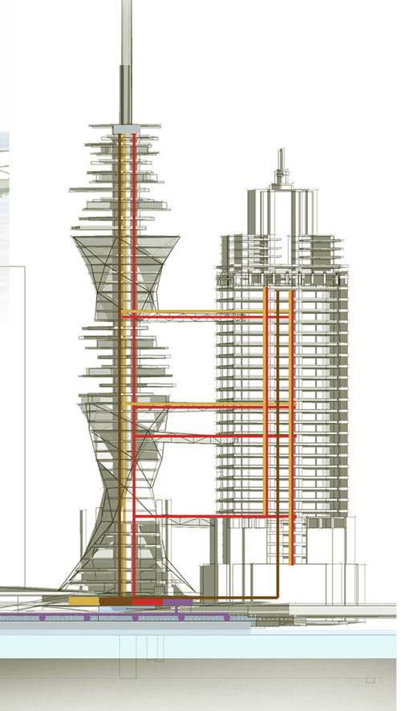
What is text structure?
Text structure is how information is organized in a passage
The structure can change multiple (many) times in a passage

Slide 3
Types of Text Structure
There are six (6) common types of text structure:
Cause and Effect
Chronological Order
Compare and Contrast
Problem and Solution
Sequence/Process
Spatial/Descriptive

Slide 4
Review
With your neighbor, answer these questions:
What is text structure?
How many types of text structure exist?
Pick two and describe them.
You have 1 minute and 30 seconds to discuss.
Be prepared to share your responses!

Slide 5
Cause and Effect
The results of something are explained.
What is a cause?
Something that gives rise to an action
What is an effect?
A result of an action

Slide 6
Cause and Effect
Example:
Becky Smith was invited to go to see “Breaking Dawn” with a group of her friends. Becky’s mom told her she could see the movie, but only if she cleaned her room and washed the dishes. Becky was so focused on picking out the perfect outfit that she forgot about her mom’s rule. Because Becky did not do her chores, she was not allowed to go the movie.

Slide 7
Cause and Effect
With your neighbor, identify the cause in the passage.
You have 45 seconds.
Becky Smith was invited to go to see “Breaking Dawn” with a group of her friends. Becky’s mom told her she could see the movie, but only if she cleaned her room and washed the dishes. Becky was so focused on picking out the perfect outfit that she forgot about her mom’s rule. Because Becky did not do her chores, she was not allowed to go the movie.

Slide 8
Cause and Effect
With a neighbor, identify the effect in the passage.
You have 45 seconds.
Becky Smith was invited to go to see “Breaking Dawn” with a group of her friends. Becky’s mom told her she could see the movie, but only if she cleaned her room and washed the dishes. Becky was so focused on picking out the perfect outfit that she forgot about her mom’s rule. Because Becky did not do her chores, she was not allowed to go the movie.

Slide 9
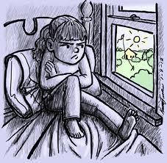
Cause and Effect
Cause
Becky did not do her chores.
Effect
Becky was not allowed to go to the movie.

Slide 10
Chronological Order
Information is organized in order of time.

Slide 11
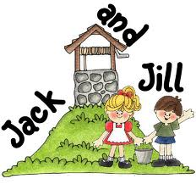
Chronological Order
Jack and Jill ran up the hill to fetch a pail of water. Jack fell down and broke his crown and Jill came tumbling after.

Slide 12
Chronological Order
Re-write the example so that it is not in chronological order.
Do not make up your own sentences! Just rearrange the sentences!
Jack and Jill ran up the hill to fetch a pail of water. Jack fell down and broke his crown and Jill came tumbling after.
You have three minutes.

Slide 13
Chronological Order
Share your version with your neighbor.
Do either of your versions make sense?
Why is chronological order so important?
You have two minutes to discuss.
Be prepared to share your responses.

Slide 14
Compare and Contrast
Two or more things are described
Their similarities and differences are discussed/analyzed.

Slide 15
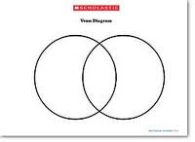
Compare and Contrast
Using a Venn Diagram (illustrated below), we’ll compare and contrast Carleton Middle School & Grissom Middle School.
We will only be using facts—not opinions!
For example, we can discuss their locations, mascots, school colors, population, cultural diversity, etc.

Slide 16
Compare and Contrast
Differences
Carleton Middle School
Grissom Middle School

Slide 17
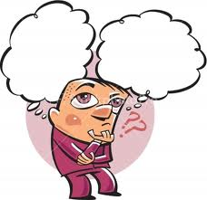
Problem and Solution
A problem is described and a response or solution is proposed or explained.

Slide 18
Problem and Solution
Read the following passage.
Identify the problem and solution with your neighbor.
Write down your answers in your notes.
You will have I minute.

Slide 19
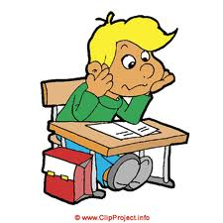
Problem and Solution
The volume in the hallway after lunch is an increasing problem. Loud students in the hallway disrupt the learning of those in class. Therefore, the teachers should enact a silent hallway policy to protect the learning of all students.

Slide 20
Problem and Solution
What’s the problem?
Students are too loud in the hallways.
What’s the solution?
Teachers should enact a silent hallway policy.

Slide 21
Sequence/Process
Information is organized in steps.
A process is explained.

Slide 22
Sequence/Process
Take out a piece of paper for this activity.
Activity:
Marvin the Martian has just landed in Spring Grove, PA. Marvin is rather hungry and really wants to eat a bowl of cereal with milk, but he doesn’t know how! Write out each step Marvin must take to properly prepare and eat a bowl of cereal.
*You will have 2 minutes to write out these steps!
Be prepared to share your answers.

Slide 23
Sequence/Process
Get a clean bowl from the cabinet.
Take out a clean spoon from the utensil drawer.
Pick the cereal you want.
Retrieve the milk from the refrigerator.
Pour the cereal into the bowl, but don’t fill it up all the way!
Pour the milk into the cereal, but don’t pour too much!
Use the spoon to scoop out the cereal and milk and bring it to your mouth.
Chew, swallow, repeat until the cereal is gone!

Slide 24
Sequence/Process
Thank you, earthlings!

Slide 25
Spatial/Descriptive
Information is organized in order of space (top to bottom, left to right).
Example:
When you walk into my living room, my sofa and a bookcase is to your right. To your left are the stairs leading to the second floor. The second bookcase is directly in front of you. On top of the second bookcase is my navy teddy bear.

Slide 26
Closure
With a neighbor, answer the following questions:
What is text structure?
What are the six types?
Pick two to explain to your neighbor.
Which is the most challenging structure for you?
*You will have 3 minutes.
*Be prepared to share your answers!

