Slide 1
Characterization
The Elements of Fiction

Slide 2
How do we get to know characters?
Characterization
The way a writer reveals a character.
Good Characterization vs. Poor Characterization

Slide 3
Two Types of Characterization
Direct Characterization
Indirect Characterization

Slide 4
Direct Path Home

Slide 5
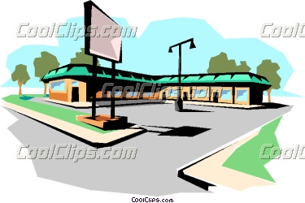
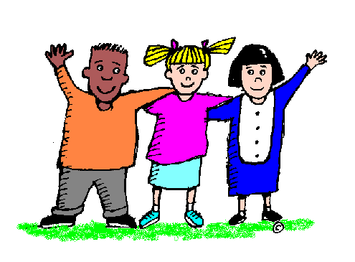
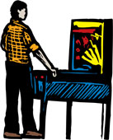
Indirect Path Home

Slide 6
Characterization
Direct Characterization
Author directly states what the character is like.
Indirect Characterization
The author illustrates what a character is like through their actions, words, etc.

Slide 7
Direct Characterization
Stating directly what the character is like.
Examples:
Sergeant Randolph was the cruelest drillmaster in the army.
Matt liked to play video games.
Sarah was rude and annoying.

Slide 8
Indirect Characterization
Five Types of Indirect Characterization
Speech (What the character says.)
Thoughts (Character’s thoughts and feelings)
Effects on Others (How others respond to character.)
Actions (What the character does.)
Looks (Character’s physical description.)

Slide 9
Indirect Characterization
Speech – Character’s Words
Example:
“I do not have to do what you say,” declared Darlene, pinching the new baby sitter.

Slide 10
Indirect Characterization
Thoughts – Character’s thought and feelings.
Example:
Ashley didn’t like the looks or smell of the squash pudding but decided to eat some to please the cook.

Slide 11
Indirect Characterization
Effect on Other Characters
Example:
“Go wake up my sister?” Lulu said. “Sure, Mom. Just give me armor and a twenty-foot pole, and I’ll be ready to go.”

Slide 12
Indirect Characterization
Actions – What the character does.
Example:
Toni glanced around, then tossed the empty soda can on the grass and kept walking.

Slide 13
Indirect Characterization
Looks – Character’s Physical Description
Example:
Wanda’s hair was pink, and every pink hair stuck up from her head. Underneath all the pink hair though, was a pair of very innocent, scared blue eyes.

Slide 14
Which type of characterization is more effective?
Direct Characterization:
Helga was angry at Tommy.
Indirect Characterization:
Helga’s eyes narrowed as Tommy walked into the room. Tommy saw Helga shake her head slightly at him and he quivered in fear. Helga felt heat rise up inside of her, threatening to burst at any moment in the direction of Tommy.

Slide 15
Direct or Indirect?
Direct Characterization
Sam is rude to animals.
Sam laughed as he tormented the cat with his new water gun by squirting the cat in the eyes.
Indirect Characterization

Slide 16
Direct or Indirect?
Direct Characterization
Louella doesn’t like school.
Louella reluctantly pulled her backpack on her shoulders and walked, hunched over, into the school building. She sighed deeply as she trudged to her locker for yet another day of school.
Indirect Characterization

Slide 17
Direct or Indirect?
Tears poured out of Joey’s eyes as his teammates tried to console him following the football game. “It’s okay, man! We’ll get them next time,” his teammates said. Joey shrugged them off and walked slowly to the locker room to change.
Joey was sad his team lost the football game.
Indirect Characterization
Direct Characterization

Slide 18
Checking for Understanding
What does the acronym STEAL stand for?
S
T
E
A
L

